Slide 1
WELCOME TO BI- MONTHLY SCIENTIFIC SEMINAR
Presented by
Dr. Md Momtazul Hoque
Assistant Professor
Dept. of pediatric surgery
SSMC & MH, Dhaka.

Slide 2
HYPOSPADIAS SURGERY- OUR EXPERIENCE IN
LAST FOUR YEARS AT SSMC & MH.
(2009-2013)

Slide 3
HYPOSPADIAS
Hypo- below,
Spadon- orifice
Urethral meatus opens on ventral side of the penis, proximal to the tip of glans penis
Incidence ……..1/300 to 1/400

Slide 4
CLASSIFICATION (LOCATION)
DISTAL
Glandular, Coronal, Distal penile
MIDPENILE
Midshaft
PROXIMAL
Proximal penile, Penoscrotal, Scrotal, Perineal

Slide 5
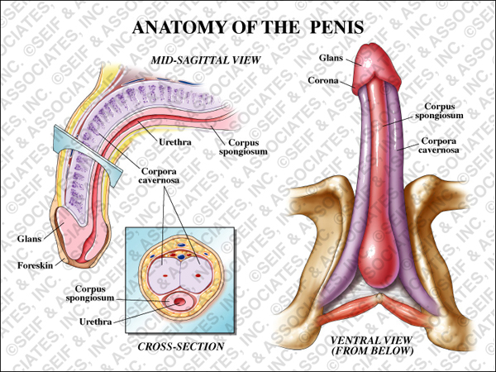
NORMAL PENILE ANATOMY
Two Corpora Cavernosa, Corpus Spongiosum
Enclosed In a Fascial Sheath- Tunica Albuginea
Bucks Fascia, Thick Fibrous Envelope
Connective Tissue, Dartos Fascia

Slide 6
FEATURES OF HYPOSPADIAS
Meatal dystopia(in the form of size, shape,position)
Dermal deffect – Frenulum absent. Dorsal hooding
Penile curvature- Chordee due to ventral tissue deficit
Peno-scrotal Transposition, bifid scrotum

Slide 7
ASSOSIATION WITH OTHER DEFECTS
Hernia : 9%
Undescended testis : 9%
Father : 9%
Siblings : 14 %

Slide 8
OBJECTIVE OF TREATMENT
Neourethra formation (Urethroplasty)
Correction of chordee (Orthoplasty)
Meatal correction at the tip of glans(Meatoplasty)
Conical shape of glans (Glanuloplasty)
Skin cover with good cosmetic appearance
Scrotal transposition (Scrotoplasy)

Slide 9
TREATMENT OPTIONS
GLANDULAR & SUBCORONAL
MAGPI
GAP
MIP
Snodgrass procedure (TIP)
MID PENILE
Snodgrass procedure (TIP)
Mathieu
Snodgraft

Slide 10
TREATMENT OPTIONS…
POSTERIOR/ PROXIMAL VARIETY
Snodgrass procedure
Transverse prepucial flap
Hadidi procedure
TWO STAGED
Buccal mucosal graft
Braka procedure

Slide 11
TIME OF SURGERY :
All the steps of surgical correction including correction of complication(if any) before school going.
Usually within 6–18 months of age.

Slide 12
ESSENTIAL CONSIDERATIONS
Proper selection of patient for appropriate procedure.
Skilled &Experienced surgical approach.
Control of bleeding ( tourniquet, Epinephrine, correct tissue plane)

Slide 13
ESSENTIAL CONSIDERATIONS Cont.
FINER INSTRUMENTS:
Fox scissors
Needle holder
Iris forceps
Fine mosquito
forceps
5. Skin hook

Slide 14
ESSENTIAL CONSIDERATIONS Cont.
SUTURE MATERIALS
Vicryl 6-0, 7-0, 8-0
(for neourethra & skin)
Proline 5-0/6-0.
(for fixation of catheter, stay suture)

Slide 15
ESSENTIAL CONSIDERATIONS Cont.
MAGNIFICATION
Optical Loupe
Magnifying glass
Good light

Slide 16
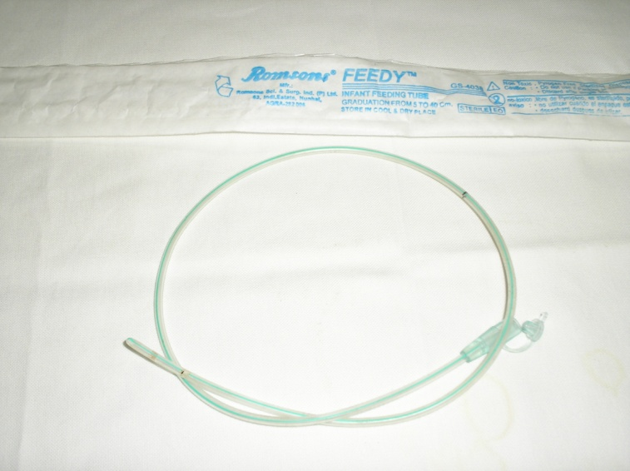
ESSENTIAL CONSIDERATIONS Cont.
OTHERS
Marker pen
Catheter(Romson feeding tube size 6 Fr, 8 Fr.)
Parenteral Antibiotics,
Adequate analgesic.

Slide 17
COMPLICATIONS
Bleeding & hematoma
Meatal stenosis
Urethrocutaneous fistula
Infection
Urethral diverticula
Recurrent curvature / stricture
Failed urethroplasty(total / partial disruption)

Slide 18
PICTURE GALLERY
Meatus at corona
Appearance of hypospadic penis

Slide 19
Stay suture

Slide 20
Marking of sub coronal collar & urethral plate

Slide 21
Dessection of glans wing
Glans wing
Urethral plate

Slide 22
Formation of new urethra (by 7/0 vicryl)
New urethra

Slide 23
Glans suturing

Slide 24
Glanuloplasty completed

Slide 25
Dorsal split & skin suturing

Slide 26
Final looking just after operation

Slide 27
Dressing

Slide 28
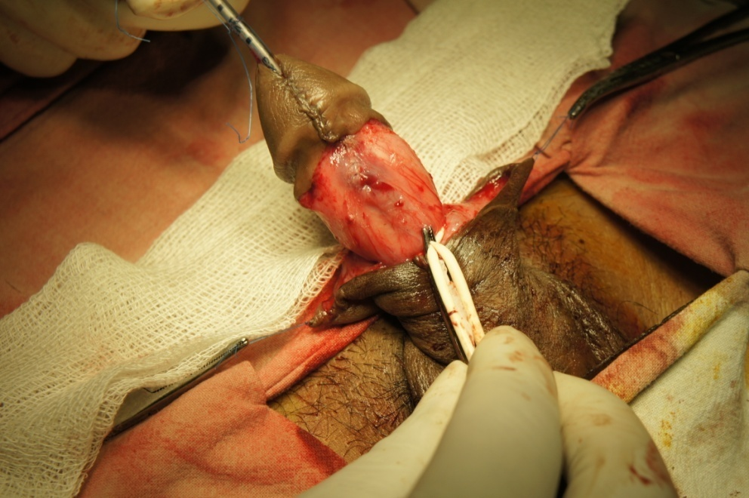
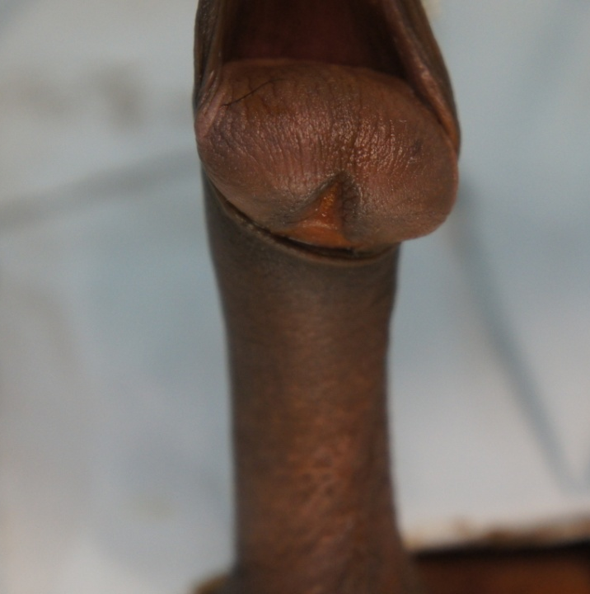
Sub coronal variety with marked chordee (a boy of 15 yrs)
Tube formation & glanuloplasty
Chordee
Immediate after operation

Slide 29
Post operative view
On 5th pod after removing of dressing
On 7th^{th} pod after removing of tube

Slide 30
Re-do surgery for failed case
Meatal orifice
Buccal mucosa from lower lip

Slide 31
Grafting of mucosa & neourethra formation
neourethra
Mucosa grafted

Slide 32
Glanuloplasty & shaft covering
Good cosmesis
Conical glans

Slide 33
RESULTS
Age of the pts : 20 months to 16 yrs
Total number of Hypospadias pts :139
Around 15-20% of admitted pts.

Slide 34
2009 Number of pts :23
Type | With Chordee | Without Chordee | Surgery
 |  |  | Primary | Stage | Redo
Distal Penile | 01 | 09 | 10
Mid Penile | 04 | 02 | 04 | 02
Proximal Penile | 03 |  |  | 03
Failed urethroplasty |  | 01 |  |  | 01
U-C Fistula |  | 03

Slide 35
2010 Number of pts : 27
Type | With Chordee | Without Chordee | Surgery
 |  |  | Primary | Stage | Redo
Distal Penile | 02 | 09 | 11
Mid Penile | 04 | 03 | 06 | 01
Proximal Penile | 03 | 01 | 01 | 03
Failed urethroplasty |  | 01 |  |  | 01
U-C Fistula |  | 04

Slide 36
2011 Number of pts : 30
Type | With Chordee | Without Chordee | Surgery
 |  |  | Primary | Stage | Redo
Distal Penile | 02 | 12 | 14
Mid Penile | 04 | 02 | 06
Proximal Penile | 04 |  |  | 04
Failed urethroplasty |  | 02 |  |  | 02
U-C Fistula |  | 04

Slide 37
2012 Number of pts :41
Type | With Chordee | Without Chordee | Surgery
 |  |  | Primary | Stage | Redo
Distal Penile | 02 | 19 | 21
Mid Penile | 06 | 03 | 09
Proximal Penile | 06 |  | 01 | 05
Failed urethroplasty |  | 02 |  |  | 02
U-C Fistula |  | 03

Slide 38
2013 (Upto April) Number of pts : 18
Type | With Chordee | Without Chordee | Surgery
 |  |  | Primary | Stage | Redo
Distal Penile | 01 | 08 | 09
Mid Penile | 02 | 02 | 04
Proximal Penile | 02 |  |  | 02
Failed urethroplasty |  | 01 |  |  | 01
U-C Fistula |  | 02

Slide 39
OUTCOME
year | No of pts | Good outcome | complication
2009 | 23 | 14 (60%) | 09 (40%)
2010 | 27 | 19 (70%) | 08 (30%)
2011 | 30 | 25 (85%) | 05 (15%)
2012 | 41 | 36 (88%) | 05 (12%)
2013 (April) | 18 | 16 (90%) | 02 (10%)

Slide 40
COMPLICATION
Points | 2009 | 2010 | 2011 | 2012 | 2013 (April )
Uretrocutaneous fistula | 5 (20%) | 4 (16%) | 2 (6%) | 2 (5%) | 0
Meatal Stenosis | 2 (9%) | 1 (4%) | 1 (3%) | 0 | 1 (5%)
infection | 1 (4%) | 2 (8%) | 1 (3%) | 1 (2.5%) | 1 (5%)
Bleeding & Hematoma | 0 | 1 (4%) | 1 (3%) | 2 (5%) | 0
Failed Urethroplasty | 1 (4%) | 0 | 0 | 0 | 0

Slide 41
MASSAGE
Hypospadias is a disease & should be treated with adequate knowledge & skill.
Circumcision should not be done before correction of hypospadias .
Proper evaluation of patient & skilled surgical approach ended with better outcome
Our set up is now one of the better center for hypospadias surgery

Slide 42
THANK YOU ALL
WE HAVE TO GO LONG WAY --

