Slide 1
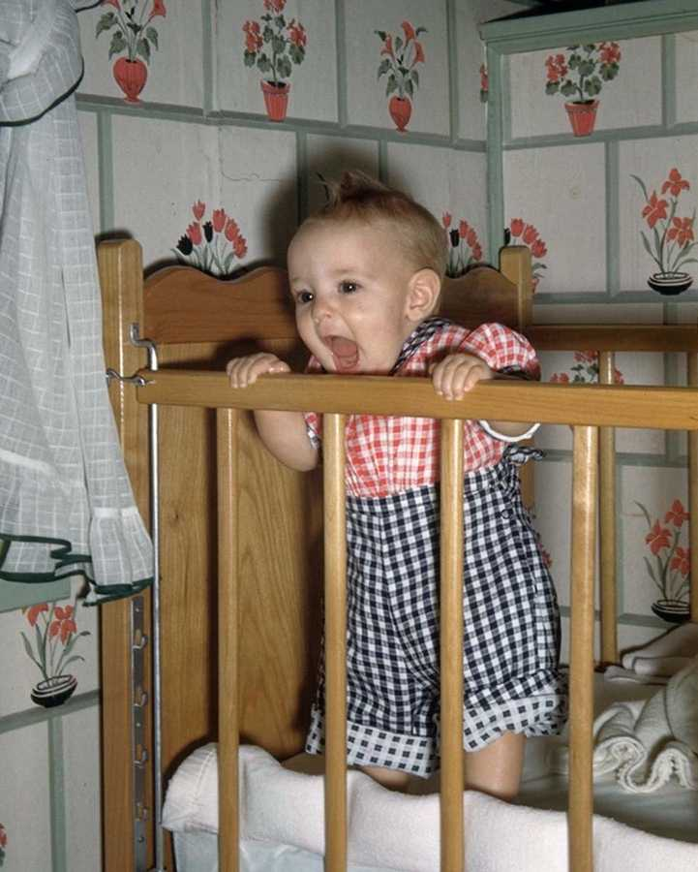
WELCOME
Dream what you want to dream
Go where you want to go
Be what you want to be

Slide 2
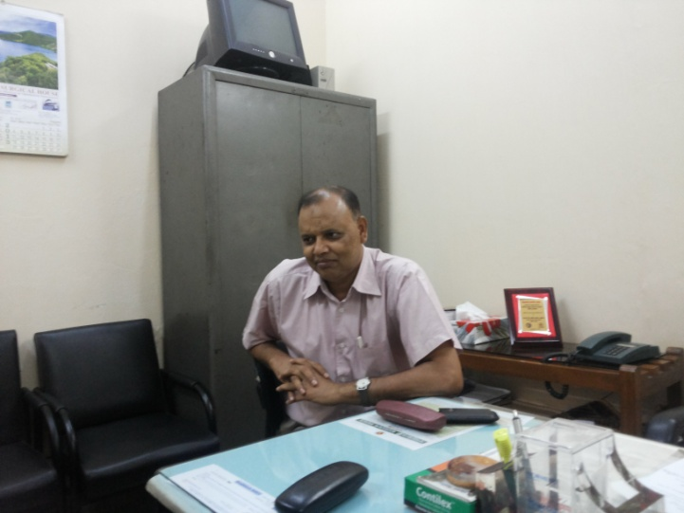
DR. Md. Samidur Rahman
MBBS,MS(pead.surgery)
Associate Professor
Department of Paediatric Surgery
Sir Salimullah Medical College & Mitford Hospital

Slide 3
HYPOSPADIAS
DEFINITION
CLASSIFICATION
CLINICAL FEATURES
ASSOCIATED ANOMALIES
INVESTIGATIONS
TREATMENT

Slide 4
DEFINITION
External urethral meatus is situated on the ventral aspect of the penis, at any site proximal to normal opening at the tip of the glans.

Slide 5
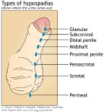
CLASSIFICATION
GLANDULAR
CORONAL
SUBCORONAL
PENILE
PENOSCROTAL
SCROTAL
PERINEAL

Slide 6
CLINICAL FEATURES
ABSENCE OF MEATUS AT THE TIP OF THE GLANS
MEATUS IS SITUATED PROXIMAL TO NORMAL SITE
MEATAL STENOSIS
CHORDEE
HOODED PREPUCE

Slide 7
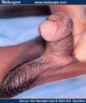
CHORDEE

Slide 8
ASSOCIATED ANOMALIES
INGUINAL HERNIA
UNDESCENDED TESTIS
URINARY TRACT ANOMALIES

Slide 9
INVESTIGATIONS
USG OF URINARY SYSTEM
OTHER ROUTINE INVTIGATIONS

Slide 10
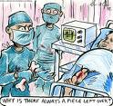
TREATMENT
Every success have to have its meaningful Goal.- ‘Pablo Picasso’
& we have to correct all the features of hyposoadias.

Slide 11
OBJECTIVE OF TREATMENT
Defects
Corrective measures
Deficit of urethra
Meatal dystopia
Chordee (Penile curvature)
Abnormal shape of glans
Dermal deffect –
Prepenile scrotum, bifid scrotum
Urethroplasty
Meatoplasty
Orthoplasty
Glanuloplasty(conical )
Skin Redistribution
Scrotal transposition/ Scrotoplasty

Slide 12
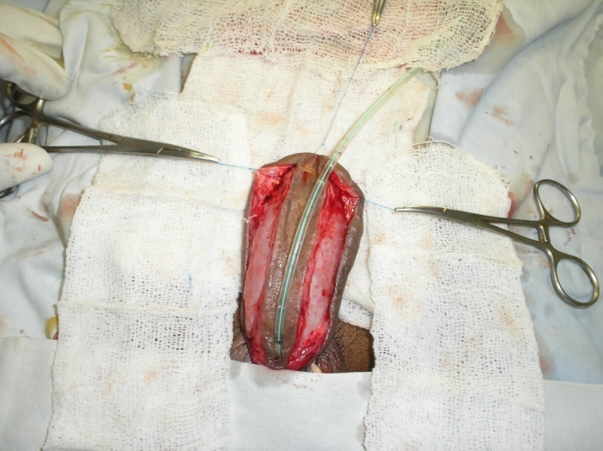

Slide 13
Final appearance of redo case

Slide 14
Prepucial skin grafted on the urethral plate area(Bracka 1st stage)

Slide 15
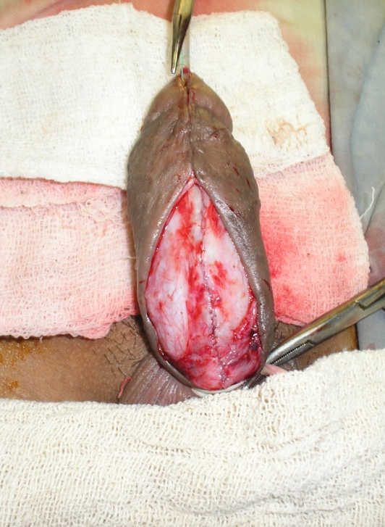
Bracka 2nd stage

Slide 16
Immediate pos-operative views.

Slide 17
Post operative views on 7th POD

Slide 18
Views on subsequent follow up.

Slide 21
TIMING OF SURGERY
MEATOTOMY as early as possible
URETHROPLASTY - 6 months to 18 months
ORTHOPLASTY at the age of 6 – 18 months then URETHROPLASTY after 6 months
ALL stages of surgery should be completed before the child goes to school.

Slide 22
THANK YOU

