Slide 1
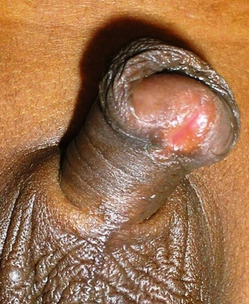
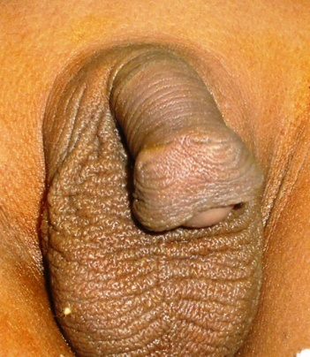
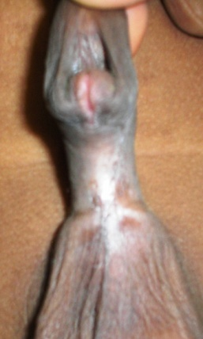
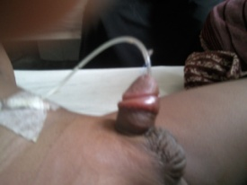
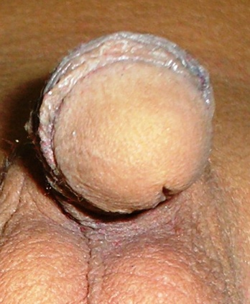
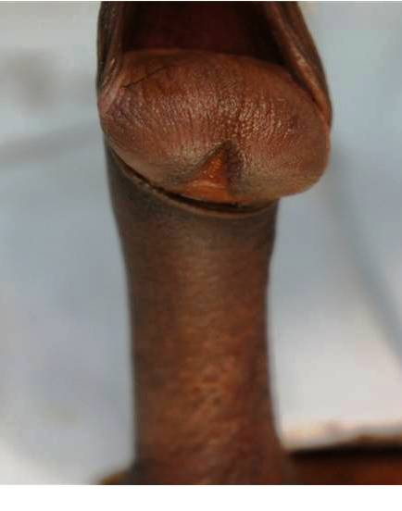
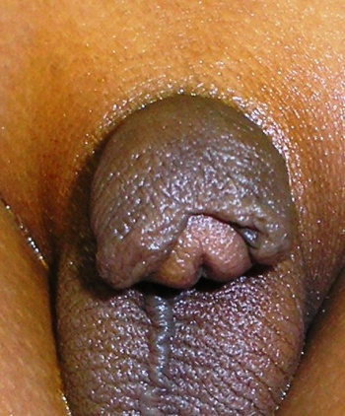
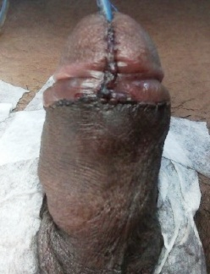
WELCOME

Slide 2
How to avoid complications in hypospadias surgery
Topic
PRESENTED
by
DR. Md. Samidur Rahman
MBBS,MS(pead.surgery)
Associate Professor
Department of Paediatric Surgery
Sir Salimullah Medical College & Mitford Hospital

Slide 3
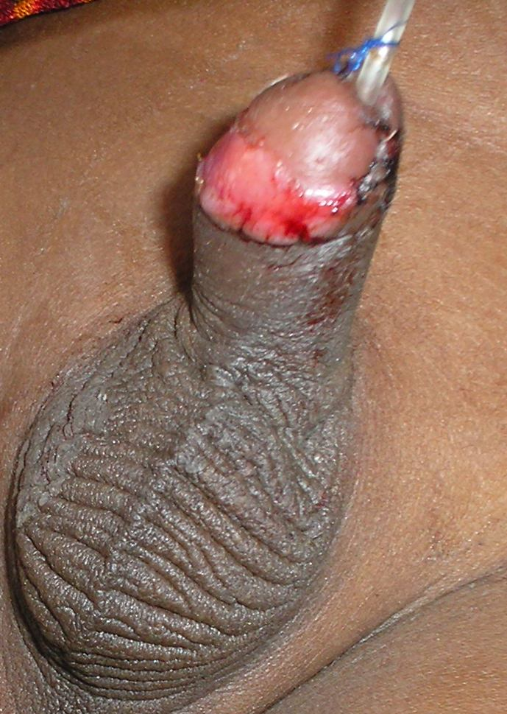
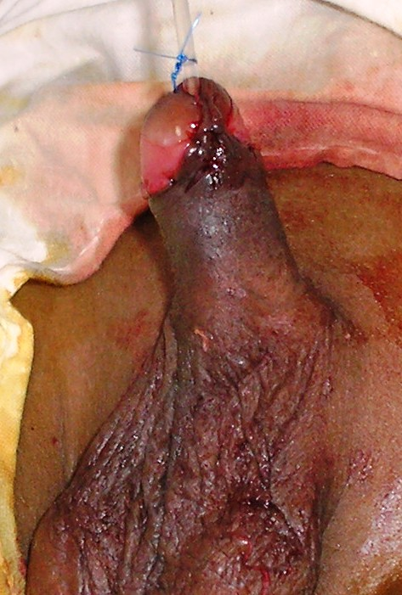
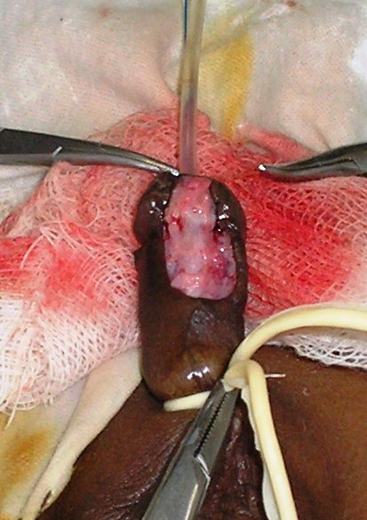
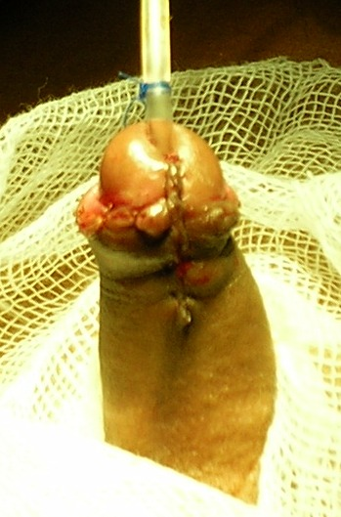
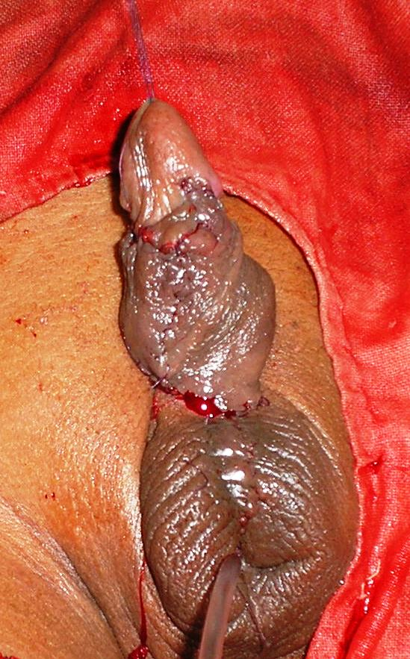
Photograph of initial outcome

Slide 4
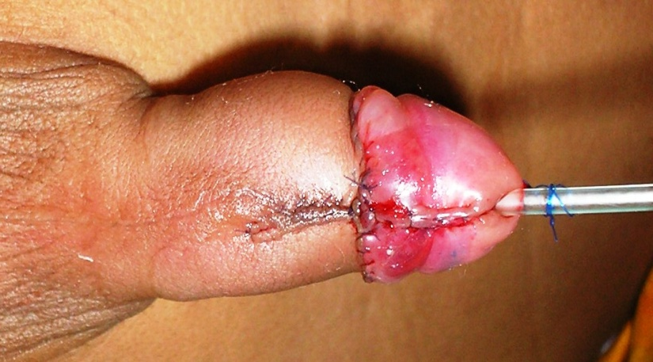
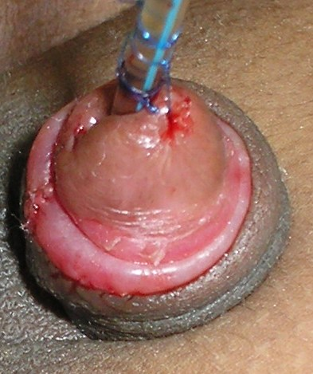
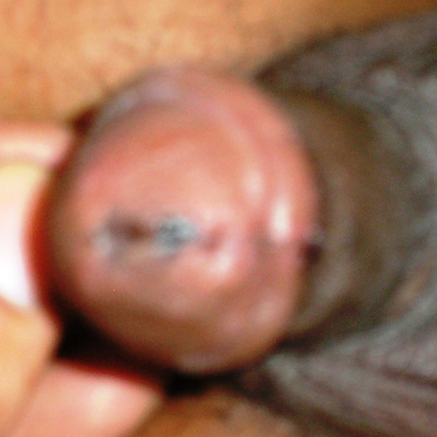
Photograph of recent outcome of hypospadias

Slide 5
Theme of presentation
“Difficulty in the journey give you an opportunity to grow stronger, more capable, wise, experienced and resilient”--- Ralph Marston

Slide 6
Outcome of hypospadias repair
Normal looking penis
Stricture with diverticulum
Meatal stenosis
Disrupted glans
Urethrocuteneous fistula
Residual chordee/ &
or Torsion of penis

Slide 7
Who will do the Hypospadias surgery ?
Hypospadiologist
Paediatric Urologist
Paediatric surgeon
Plastic surgeon
Urologist
Extended Book knowledge
Observe many
Assist many
Do individually
Teach someone
Anyone can do

Slide 8
Any scope of compromise ?
“There is no scope of compromise of any essentials in reconstructive surgery specially in hypospadias”:- A.T. Hadidi
Stitch in time saves nine

Slide 9
Make a check list
Patients
Urethral plate
narrow
Wide
Penile lenth
wait
Testosterone
healthy
Prepucial skin
Circucised
Amount
Spongious tissue
Meatus
Site,size
proxima meatal skin
Glans
skin
Mild/moderate
Chordee
Conical
Flat
Grooved
Severe

Slide 10
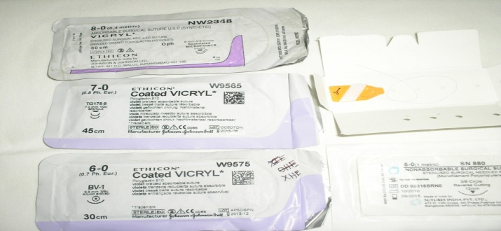
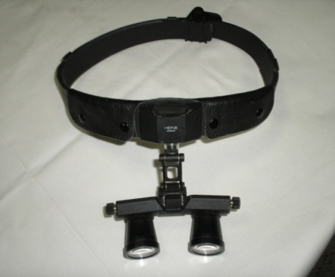
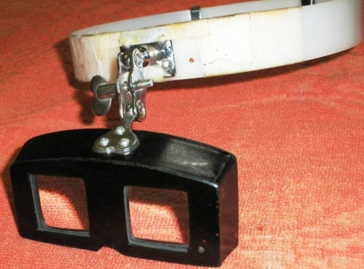
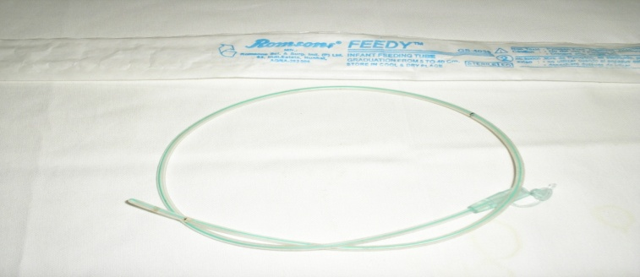
Make a cheek list
Make a check list
Essentials
Suture materials
7/0 vicryl
8/0 vicryl
Magnifications
Loupe
Magnifing glass
Urethral stent
6/0 vicyl
5/0 proline
6fr/8fr ramson feeding tube
Silicon catheter
Loupe
Magnifing glass

Slide 11
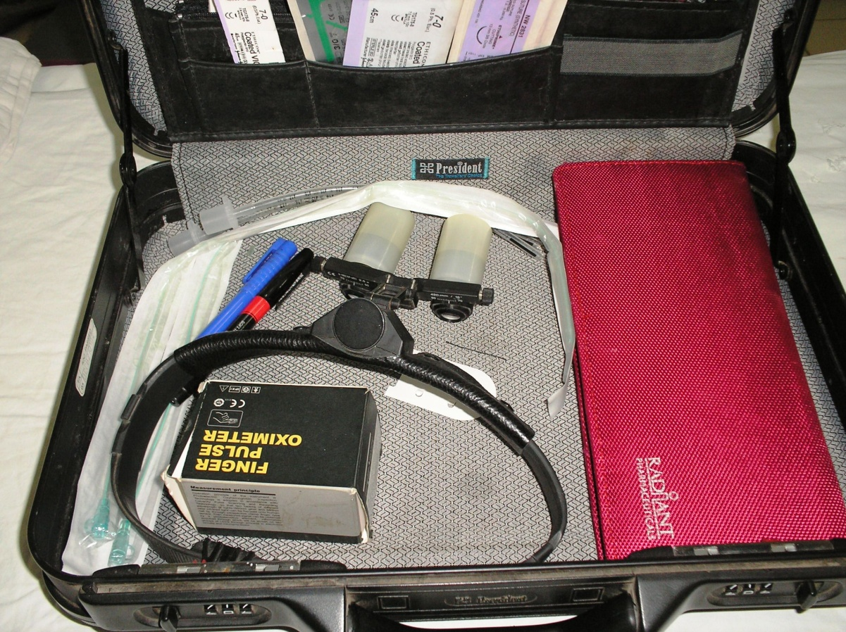
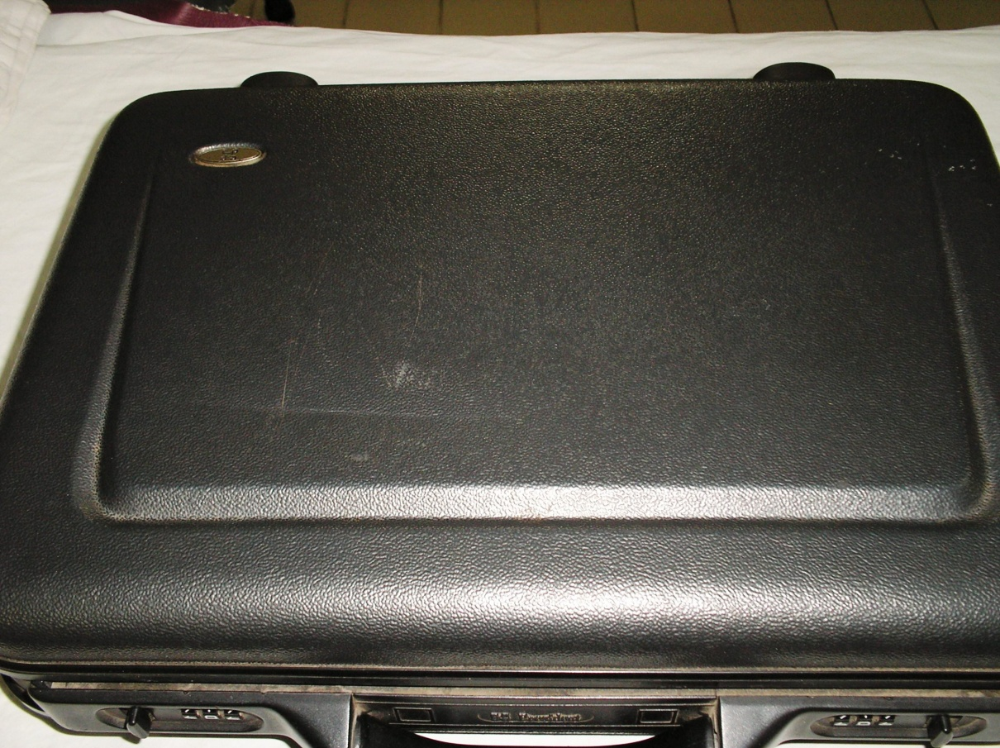
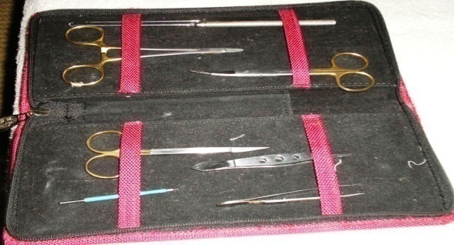
Make a check list
Instruments
Dressing materials

Slide 12
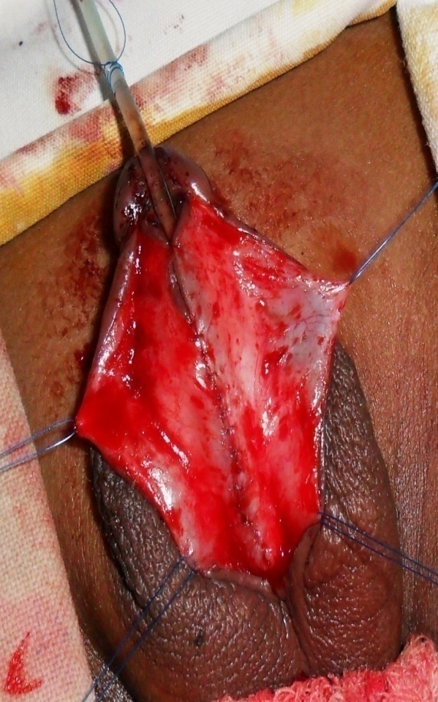
General measures
Pre-operative Evaluation
Judicial choice of proper technique
Minimal tissue damage
Stay suture & / Skin hook
Correct tissue plane
Subcuticular inverting stitching
Apply tension free and uniform suturing

Slide 13
Specific measures
Meatal stenosis
Over enthusiastic closure of distal meatus upto the tip of glans leads to meatal stenosis: Ref.-Warren T Snodgrass
Start neo-urethra formation from midglans (2-3 mm away from tip))

Slide 14
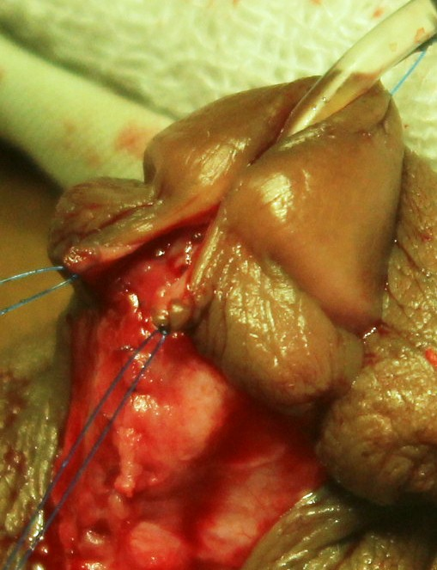
Meatal stenosis
Glans Approximation Should not proceeded upto the highest point of incision.

Slide 15
Meatal stenosis
Use larger stent / feeding tube in older children

Slide 16
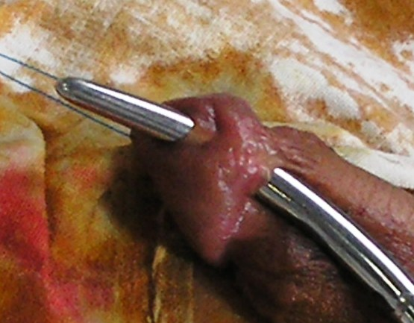
Urethrocuteneous fistula

Slide 17
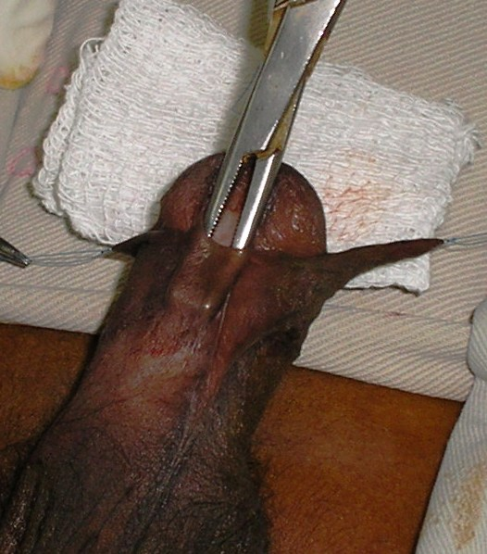
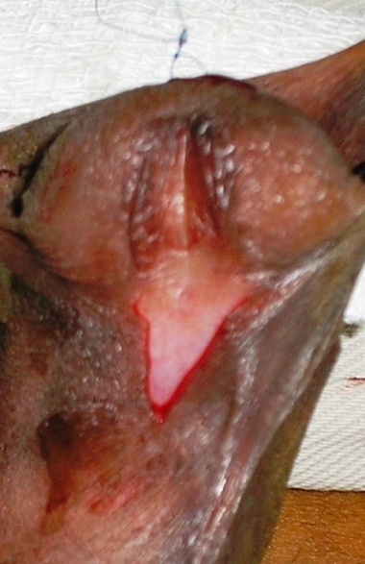
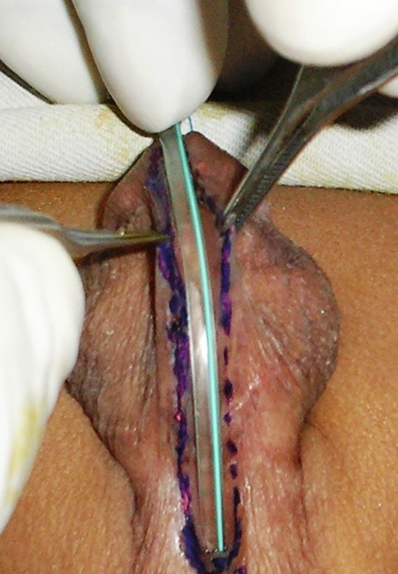
Steps to reduce the urethrocuteneous fistulas
Before incision
Cheek meatus & peri-meatal collar skin if thin-open it
Use marker pen on incision line.
Take measurement of urethral plate/ventral skin before incision.

Slide 18
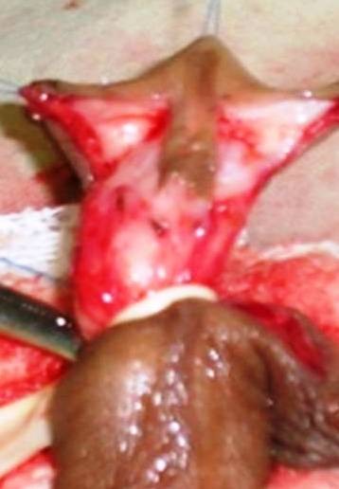
Neourethra should be on healthy well vascularised urethral plate
Make sharp incision on the urethral plate
Try to keep much spongious tissue with urethral plate

Slide 19
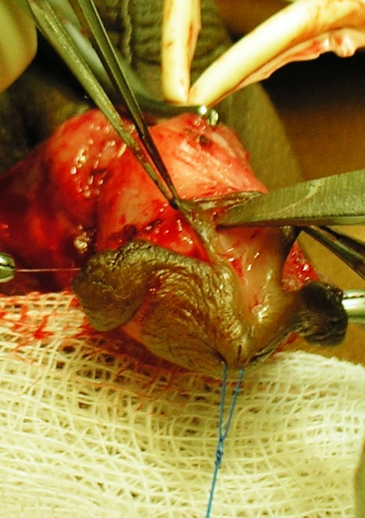
Stitch on Neo-urethra should be tension free
Urethral stent should be snugly accommodated
Strictly on the midline
Deep enough up to cavernous tissue
Incision on plate
Extend proximally 2-3 mm from meatus
Not up to the tip of glans

Slide 20
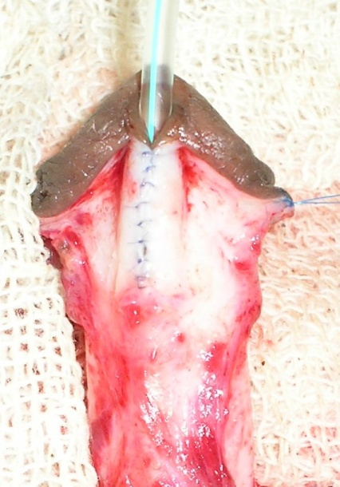
Stitch on Neo-urethra should be uniform ,secured & unique calibered
Subcuticular inverting with regular interval
Give 2nd layer to bury stitch

Slide 21
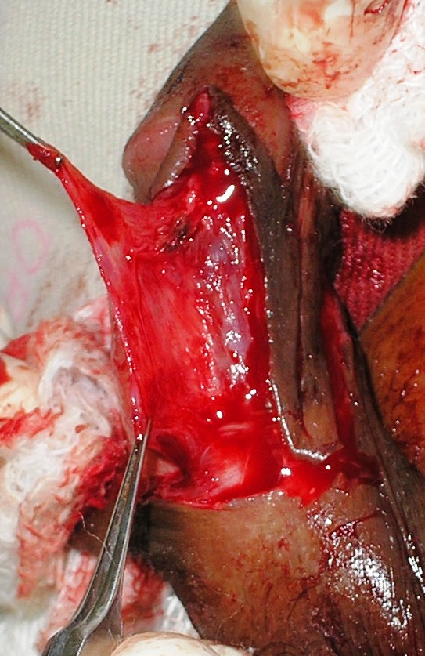
Use dartos flap to cover whole length of neo-urethra

Slide 22
In peno-scrotal/scrotal variety tunica v. flap may be use
T. Vaginalis flap

Slide 23
Extra catheter leakage of urine during 1st 2-3 POD potentiate fistula formation. Jayanthi VR-2003
Keep urethral stent just inside the bladder.
Use .5% diluted ultracaine 20ml immediate post-operative period to reduce bladder spasm.
Use laxative to prevent straining during defecation.
Give adequate pain killer during post-operative period to prevent excess crying.

Slide 24
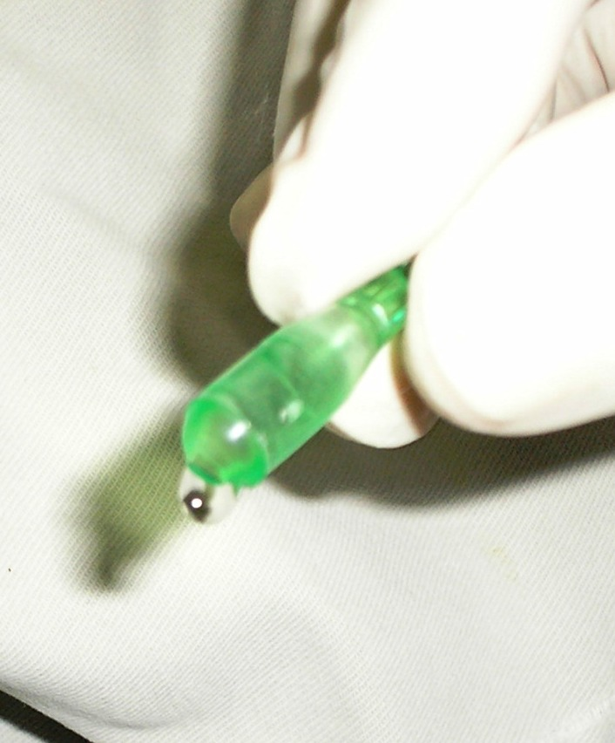
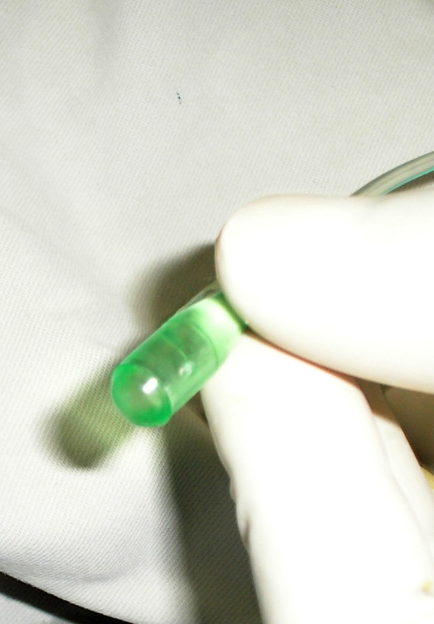
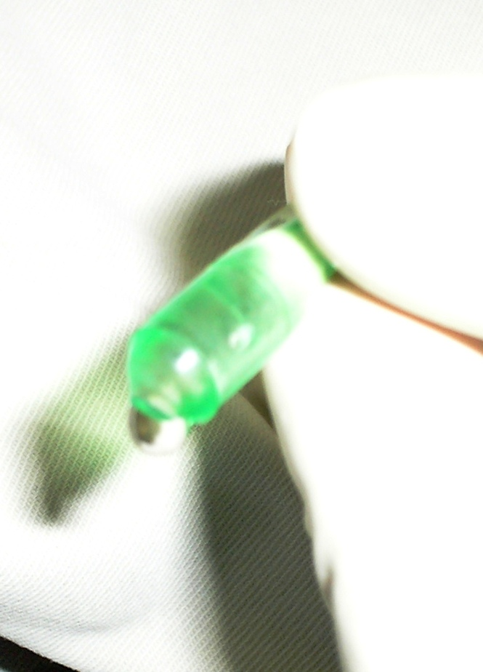
Technique of keeping stent just inside bladder

Slide 25
Post-operative infection contribute to fistula formation/ skin loss

Slide 26
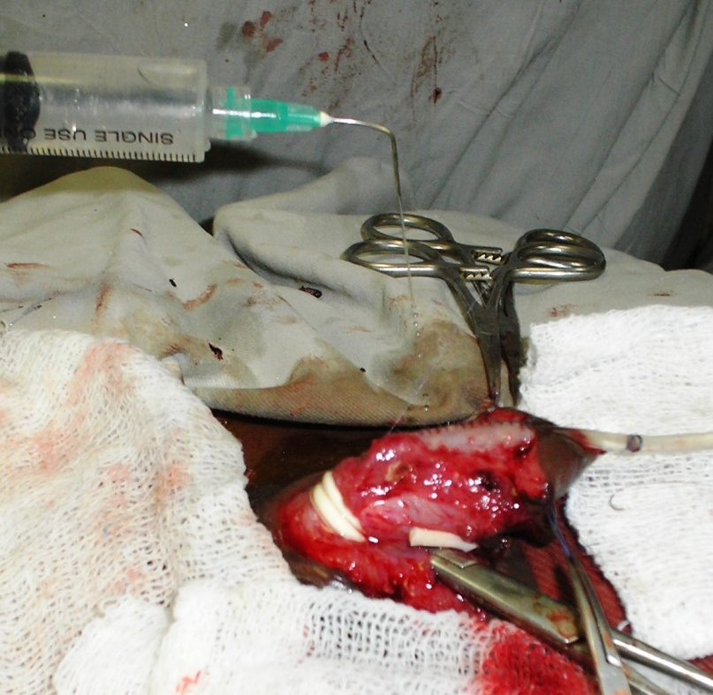
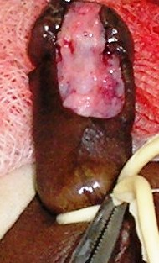
How to prevent post-operative infection
Pre-0perative prophylactic antibiotics.
Skin preparation
Repeatative wash of operative field
Post operative parentaral antibiotics
Justified use of tourniquet.

Slide 27
THANK YOU ALL
Try to avoid complications
Improving our surgical skill
VISION
MISSON
WE HAVE LONG WAY TO GO--

