Slide 1
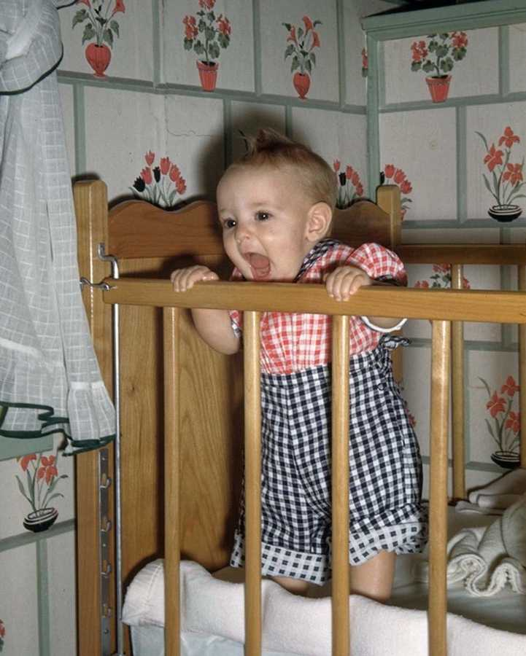
WELCOME
Dream what you want to dream
Go where you want to go
Be what you want to be

Slide 2
“How to improve hypospadias surgery”
PRESENTED
by
DR. Md. Samidur Rahman
MBBS,MS(pead.surgery)
Associate Professor
Department of Paediatric Surgery
Sir Salimullah Medical College & Mitford Hospital

Slide 3
Every success have to have its meaningful Goal.- ‘Pablo Picasso’
&
Specific.
Attainable.
Relevant.
Time Bound.
Acceptable
Measurable.
Goal should be

Slide 4
GOAL OF HYPOSPADIAS SURGERY
Meatus:
Verticaly orientated
slit like
at the tip of glans
Neo-Urethra
Age matched
calibrated
uniform whole lenth
Penile shaft
Straight penis
without residual chordee
Out-looking
Good cosmetic
Like circumcised normal looking penis
Scrotum
Scrotoplsty
Scrotal transposition
Glans penis
Conical
Smooth

Slide 5
OBJECTIVE OF TREATMENT
Defects
Corrective measures
Deficit of urethra
Meatal dystopia
Chordee (Penile curvature)
Abnormal shape of glans
Dermal deffect –
Prepenile scrotum, bifid scrotum
Urethroplasty
Meatoplasty
Orthoplasty
Glanuloplasty(conical )
Skin Redistribution
Scrotal transposition/ Scrotoplasty

Slide 6
Patients evaluation
Thorough analysis of all components of hypospadic penis.
Examine the pt once again(in admitted pt)
Take a photograph(OPD/Private pt) & keep it in your PC.
Discuss with your colleagues, Take advice/help from senior or expert.

Slide 7
What to do next?
Choice the right technique applicable to the particular pt.
Try to avoid other difficult/prolong case on the same day.
Operate the pt as first case.
Skin preparation (Soap bath, skin scrub)

Slide 8
Requirements
Good OT light.
Appropriate OT table
Fine suture materials (7/0 for neourethra, 6/0 for glans aproximation, 8/0 for glans epithelium & at corona.
Blood less/less bloody working field
( By vascular tourniquet or glove collar)

Slide 9
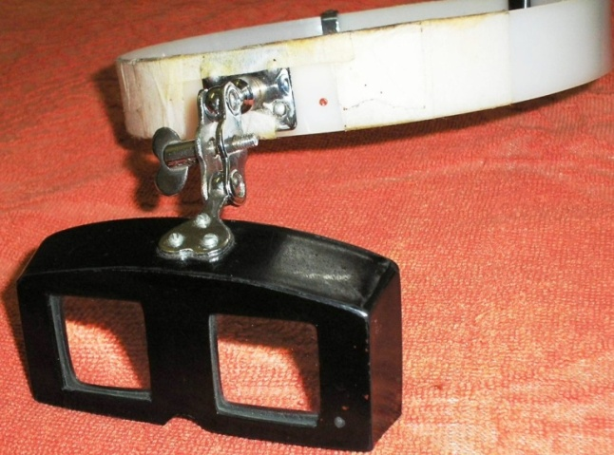
Requirements
Magnification
Advantages
Dissection through proper tissue plane
Minor vessels & Precise diathermic coagulation
Margin to margin tissue apposition
Delicate tissue handling
Loupe
Magnifing glass

Slide 10
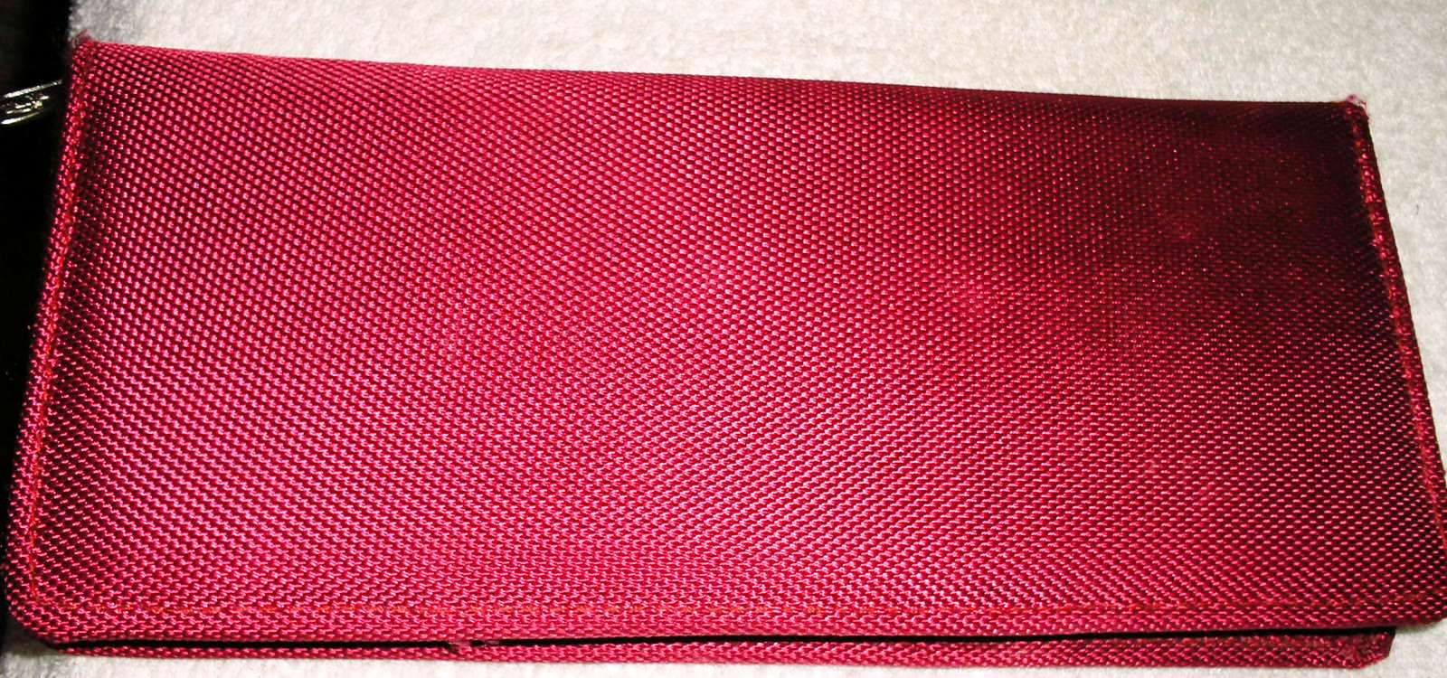
Requirements
Fine instruments
Fox scissor
Iris forceps
Fine,non sereted needle holder
Skin hooks
Pointed diathermy pin
mosquito

Slide 11
Apply stay suture as many as required( especialy at tip, prepucial & glans wing)

Slide 12
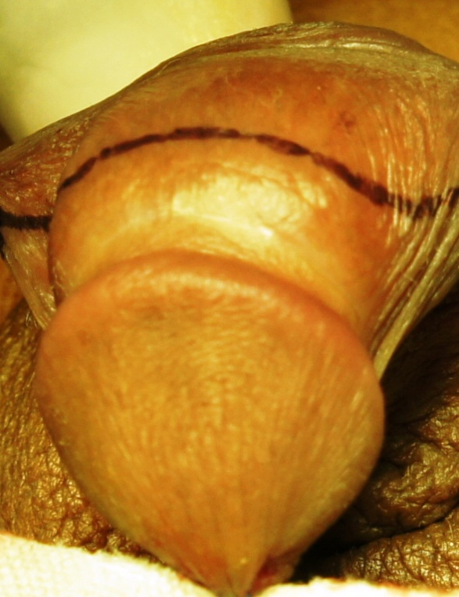
Use marker to outline the urethral plate & other incision line

Slide 13
Give incision sharply on the urethral plate margin & keep spongious tissue

Slide 14
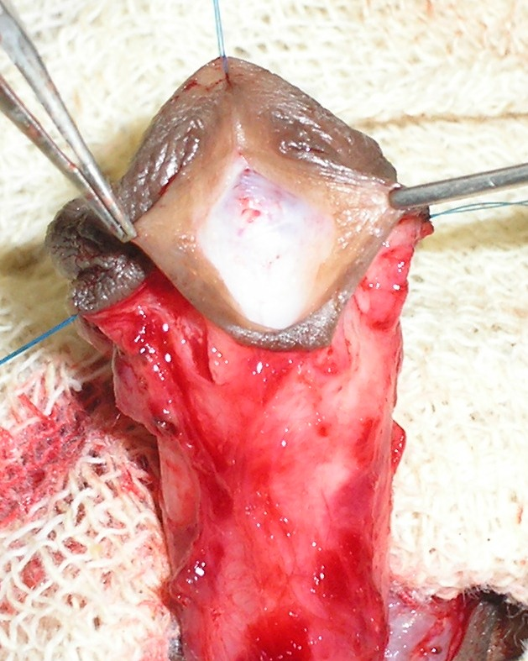
Incision on the urethral plate
Strictly on the midline
Extend proximally 2-3 mm from meatus
Not up to the tip of glans
Deep enough up to cavernous tissue
m

Slide 15
Over enthusiastic closure of distal meatus upto the tip of glans leads to meatal stenosis: Ref.-Warren T Snodgrass
Start neo-urethra formation from midglans(2-3 mm away frome tip)

Slide 16
Apply stitch on neo-urethra uniformly without tension
Give 2nd layer to bury stitch

Slide 17
Use dartos flap to cover whole length of neourethra
Spongious tissue also use for covering

Slide 18
Glans approximation should not too tight/too loose (over the neo-urethra)
Glans epithelium & at corona stitch with 8/0 vicryl

Slide 19
Excess prepucial skin excised after exact marking
Skin stitched keeping a subcoronal inner prepucial colar

Slide 20
Surgin pad may used as dressing

Slide 21
Keep the urethral stent(Romson feeding tube) open in a pot.
Prevent tube blokage by urinary sludge/sediment
Chance of accidental bed wet

Slide 22
Assessment of outcome
Meatus-Vertically oriented slit like, on the tip
Urinary flow- Forward direction, spiral, adequate volume

Slide 23
Assessment of outcome
Shaft of penis- Straight penis without chordee
Appearance-like normal circumcised penis

Slide 24
Question of Self evaluation by the surgeon himself.
Analytical recapitulation of each immediate past operated case
Keep records of all operated case & after 10-15 cases assess the outcome
Take photograph(pre, per, post and follow up) of many cases & have a look
Ref.- A.T. Hadidi. 2004.
Ref.- W.T Snadgrass
2006
Ref.-Baskin L.2001

Slide 25
Open specific folder on your PC

Slide 26
Immediate pos-operative views.

Slide 27
Final appearance of redo case

Slide 28
Prepucial skin grafted on the urethral plate area(Bracka 1st stage)

Slide 29
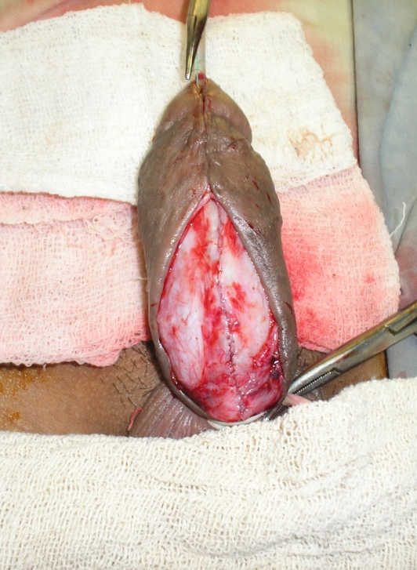
Bracka 2nd stage

Slide 30
Post operative views on 7th POD

Slide 31
Views on subsequent follow up.

Slide 32
Finally
Normal looking penis
careful planing of aplied techques
atraumatic meticulous tissue handling
covering the repair with the dartos pedicle flap
use of fine suture material
careful evaluation and analysis of deffects,

Slide 33
THANK YOU ALL
WE HAVE LONG WAY TO GO--

