Slide 1
Hypospadias ”Easy to diagnose but Hard to treat”
Professor Dr. Samidur Rahman
Deportment of pediatric surgery
Dhaka medical college hospital, Dhaka.

Slide 2
POINTS TO BE DISCUSES
Introduction
General considerations
Practical essentials / Practice essential
Surgical evaluation(facts and findings)
Planning
Brain storming
Mapping
Counseling
Choosing of most appropriate method
Commonly practicing procedures ( pros & cons)
Advance learning & understanding

Slide 3
General considerations
Definition
Developmental background
Urethra(urogenital sinus)
Chordee
Mullarian component
Intersex anomaly
Applied Anatomy
( parts &relation & blood supply)
Incidence
Associated anomalies
Features
Planning for management
Treatment options
Complications
Follow-up
Conclusion/Remarks

Slide 4
Developmental background

Slide 5
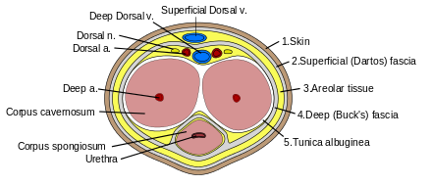
Applied Anatomy

Slide 6
Blood supply of penis
Blood supply of penile structure
Blood supply of penile skin

Slide 7
PRACTICAL ESSENTIALS / PRACTICE ESSENTIAL (features )
PRIMARY
Re-do
Meatus
Urethral plate
Peri-meatal supporting tissue
Chordee
Glans (shape , Garth , groove/ flat)
Length of penis
Availability of penile skin
Spongious tissue
Penile torsion
Scrotum
Prostatic utricle
Intersex anomaly (DSD)
Use of steroid
Meatus
Urethral plate
Peri-meatal fibrosis
Residual chordee
Glans (shape)
Skin blob/ gathering
Availability of penile skin
Scrotum
Prostatic utricle
Detailing of previous operations

Slide 8
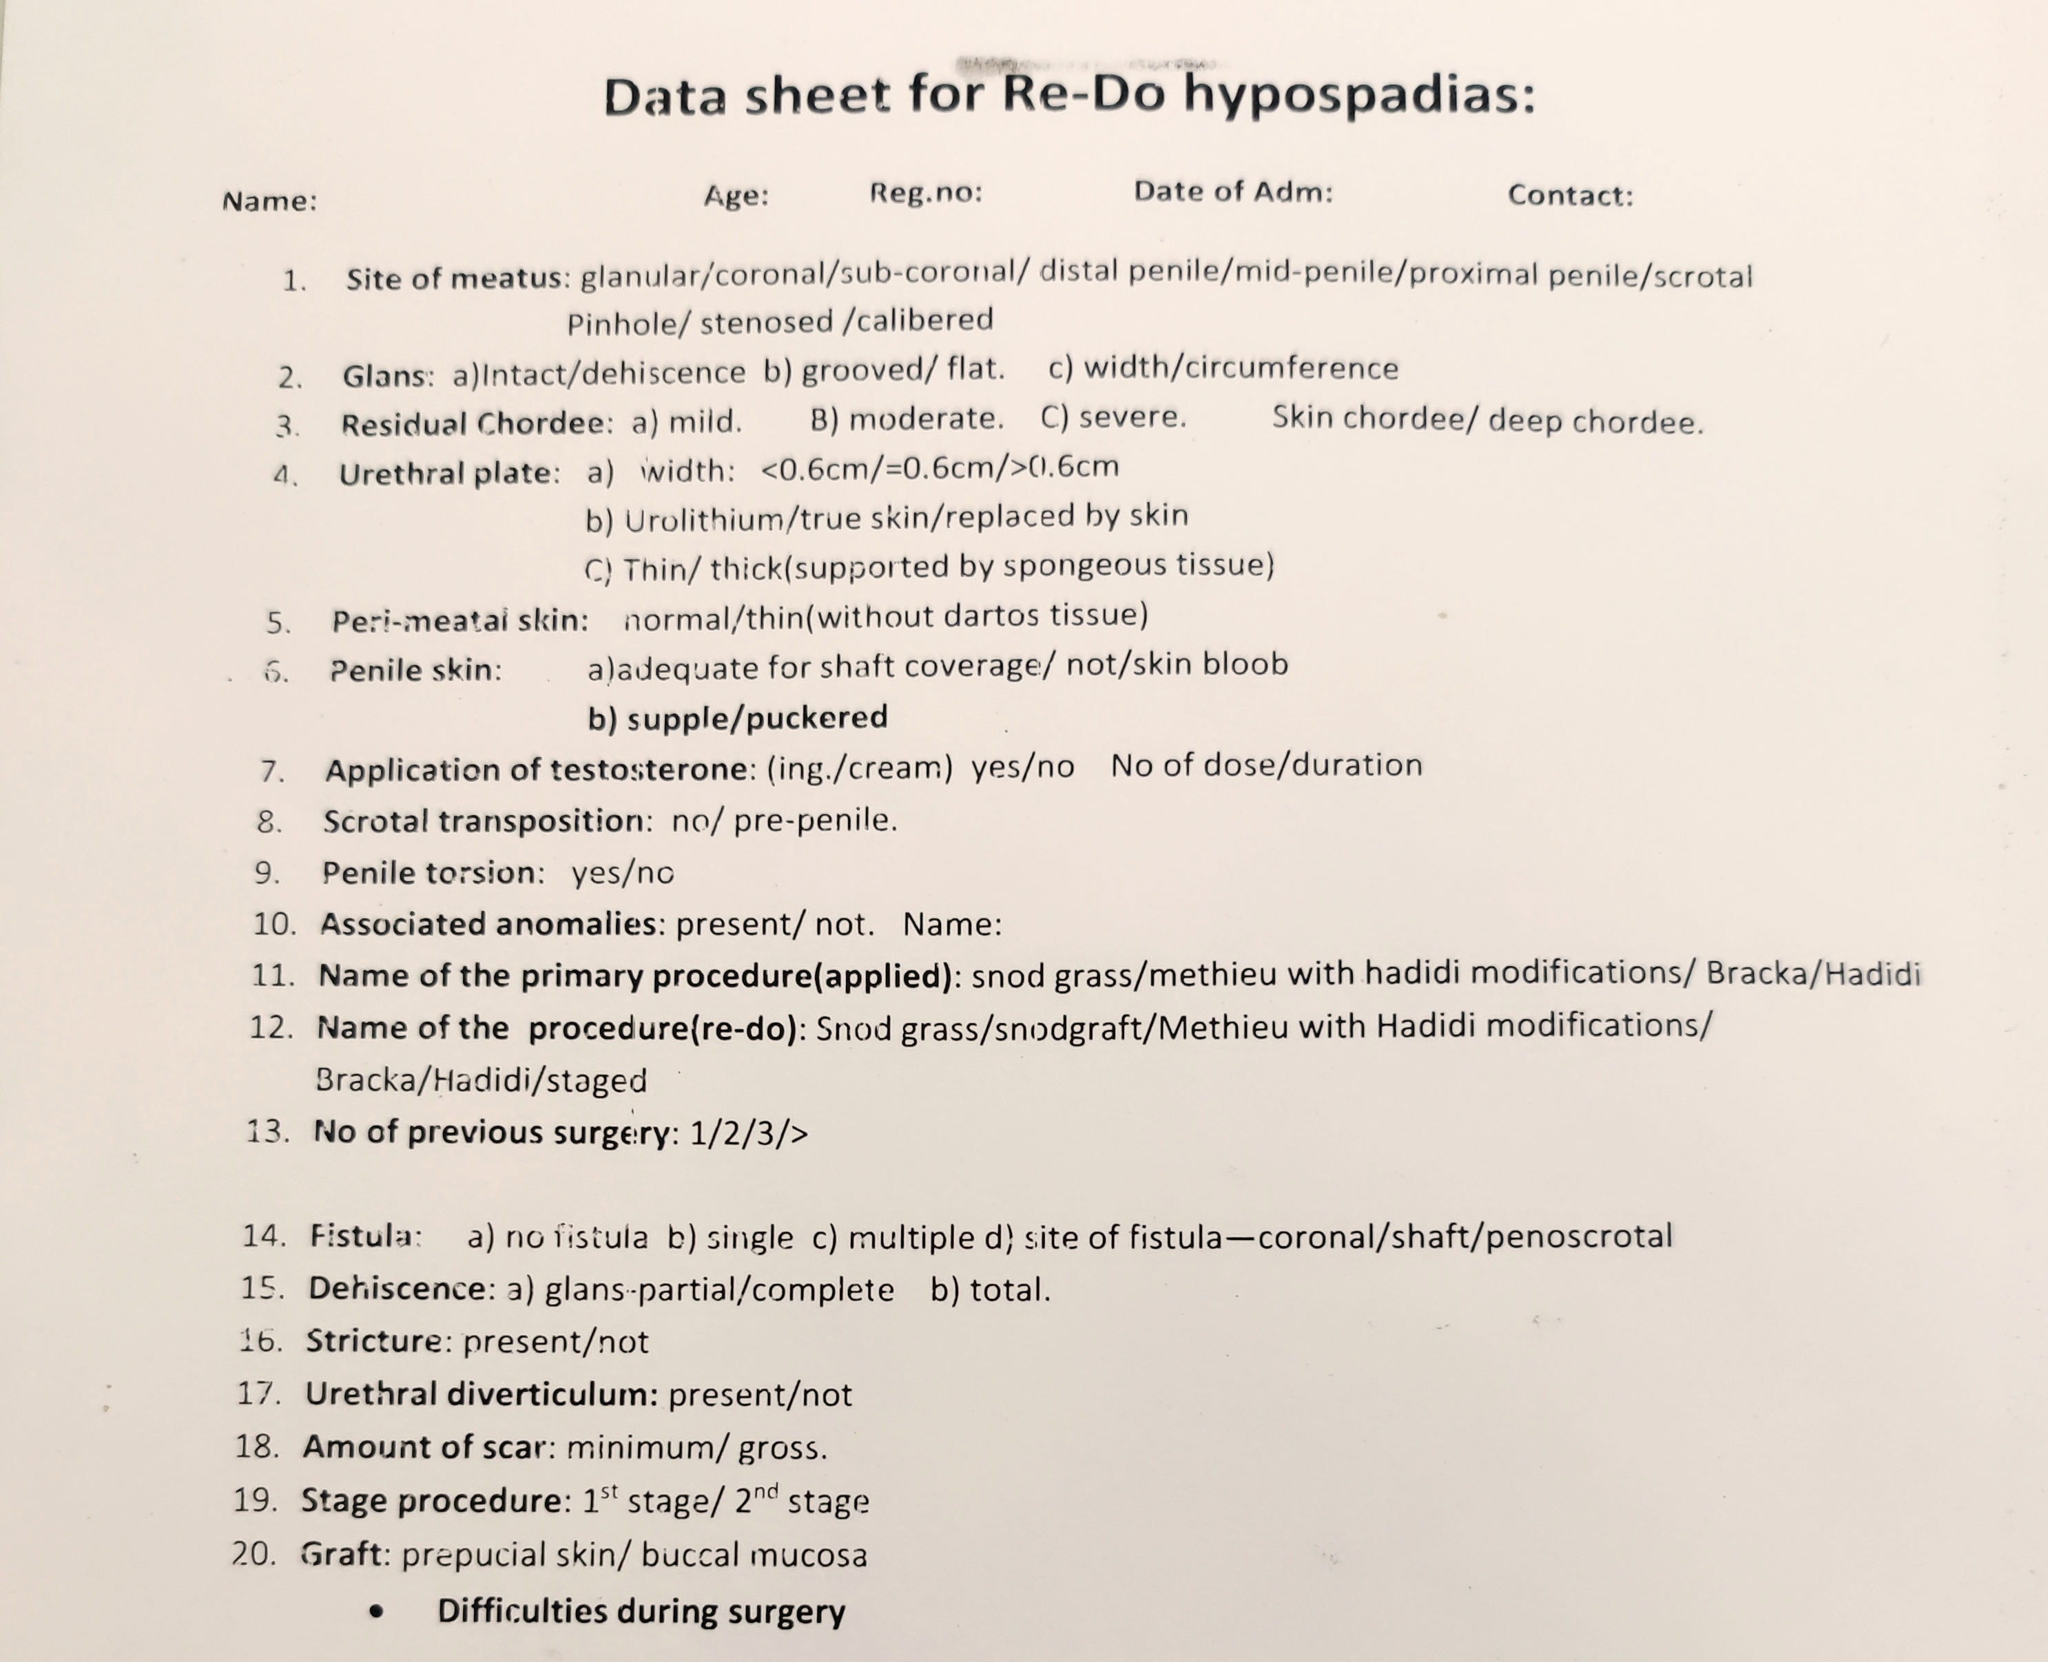
Data sheet of primary & re-do

Slide 9
PRACTICAL ESSENTIALS / PRACTICE ESSENTIAL (MEASURES)
Pre-operative
Per-operative
Soap bath/ cleaning
Painting
First case (OT list)
Avoidance of other long case/ infected case
Checking of all required materials(sutures , stent , tourniquet , dressings)
Good illumination
Marking
Meticulous tissue handling / tissue planes
Hemostasis
Tension free suture
Supporting layer
Penile covering

Slide 10
Measures
Magnification
Fine instruments
Suture materials
Dressing materials
Stent vs urethral plate (2$πr$)
Urinary drainage
Bladder spasm
Erection

Slide 11
Measures
Suturing (continuous , interrupted ,sub-epidermal , line ).
Use of local vasoconstriction agent/ diathermy.
Flashing with normal saline .
Parenteral antibiotic for 3-5 days.( cefrtriaxon&/or flucloxacillin,kacin)

Slide 12
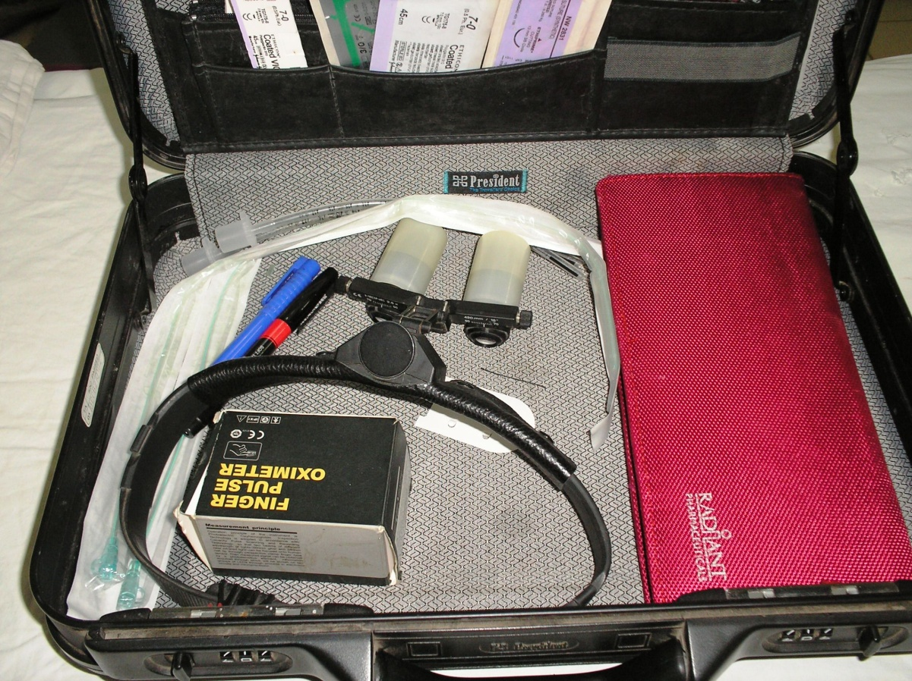
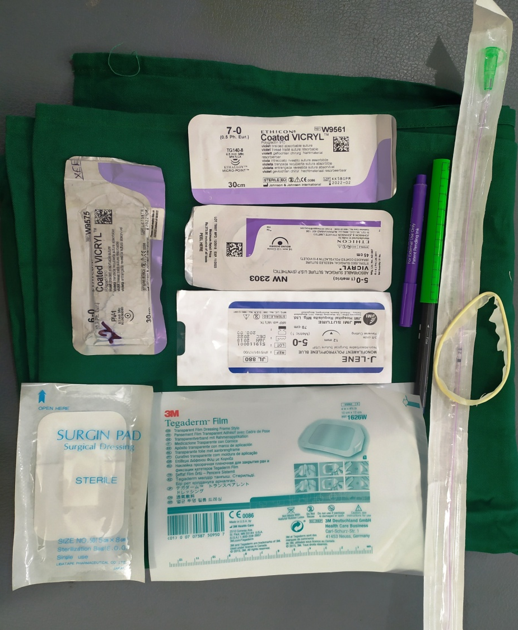
Fine instruments , loup & other essentials

Slide 13
Effect of testosterone cream
Before
After

Slide 14
Methodical and meticulous surgical approach

Slide 15
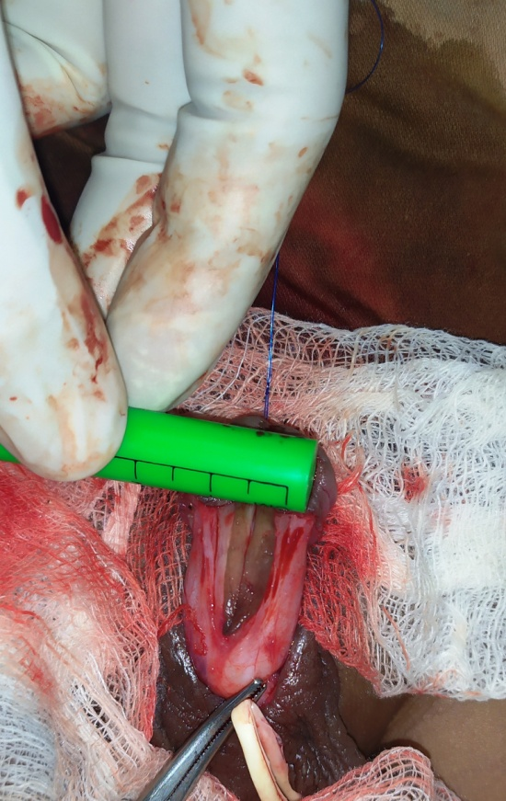
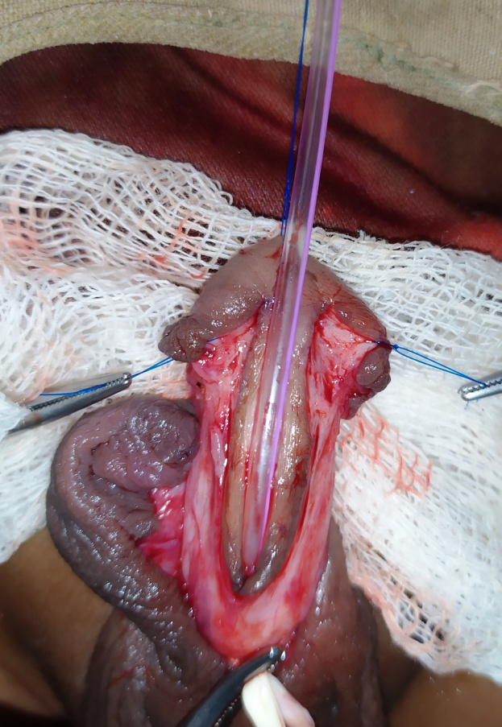
Methodical and meticulous surgical approach

Slide 16
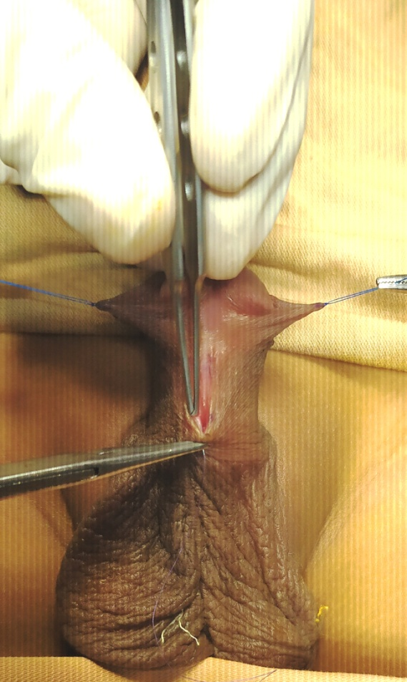
Methodical and meticulous surgical approach

Slide 17
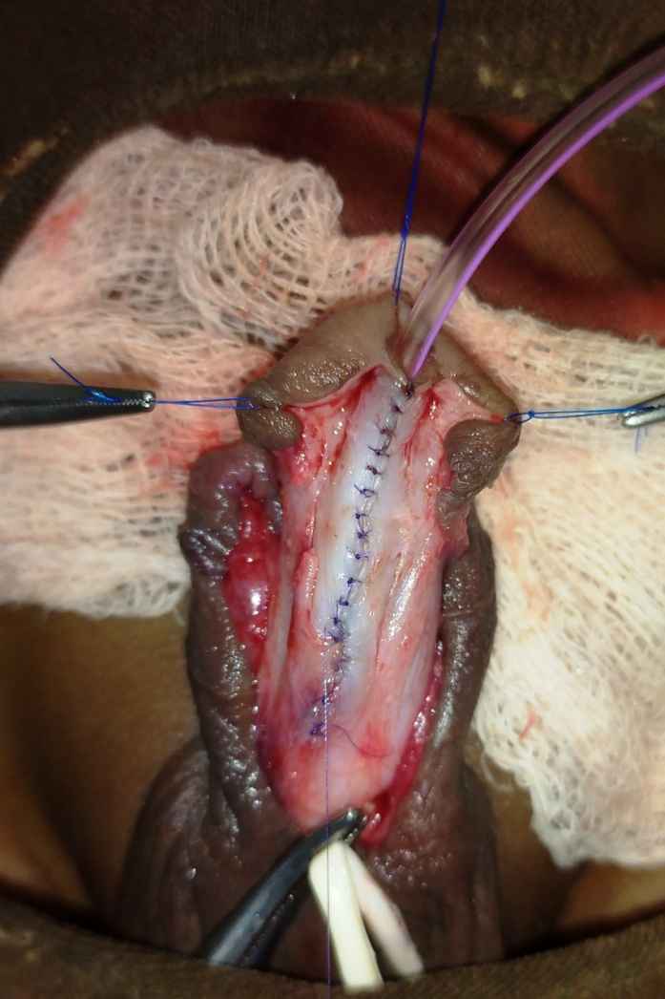
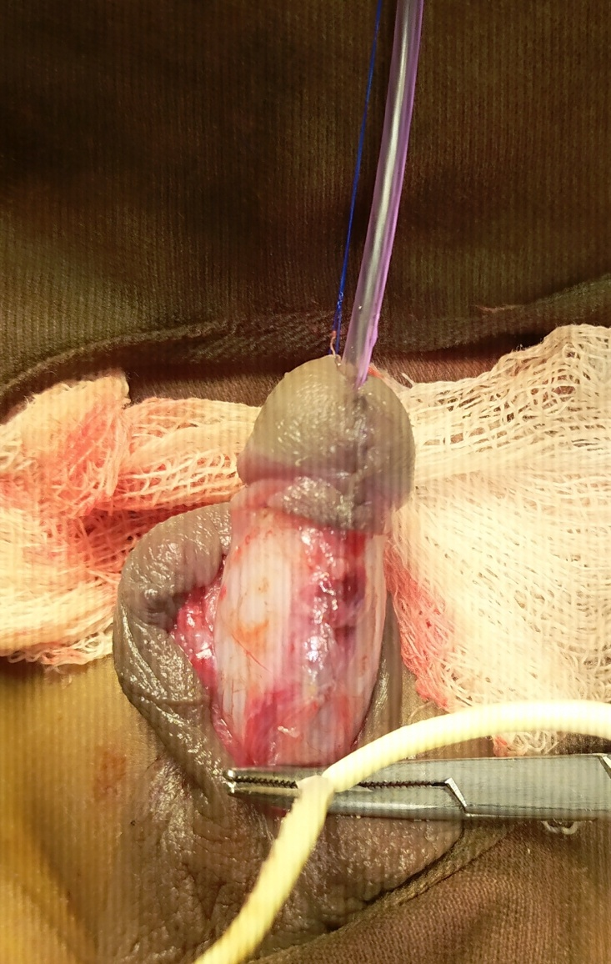
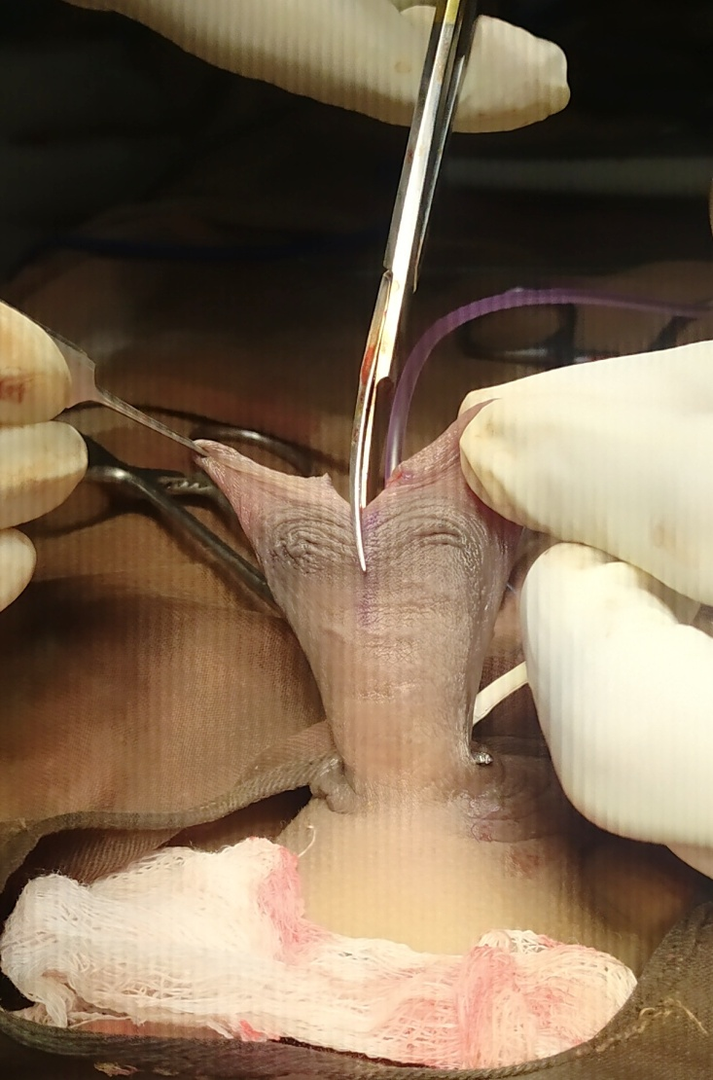
Methodical and meticulous surgical approach

Slide 18
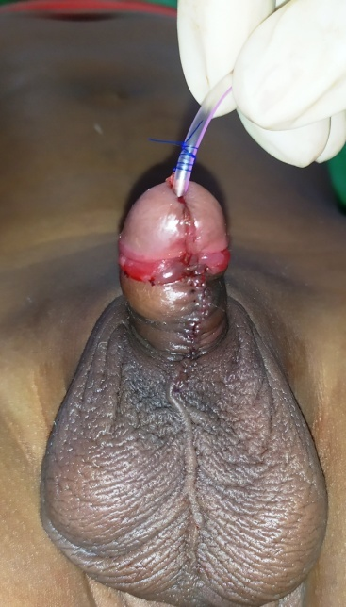
Methodical and meticulous surgical approach

Slide 19
Treatment options
Distal
Proximal
MAGPI
Snodgrass (TIPU)
Mathieu
Mathieu with hadidi modification
Mathieu with incorporation TIPU
SLAM
Snod-graft procedure
TIPU
Mathieu
Snod-graft
Braca I & braca II
Graft (preputial skin, oral mucosa)
Snod-Bush procedure
Johanson’s urethroplasty (single vs stage )
On-lay , lateral flap

Slide 20
Re-do procedures
Snodgrass
Mathieu
Braca (single or staged)
Johenson’s (single or staged )

Slide 21
COMPLICATIONS
Early
Late
Hemorrhage / hematoma
Edema
Infection
Skin necrosis
Accidental removal /Blockage of stent
Irritation of trigon
Bladder spasm
Extra stental urination
UC-fistula( recurrent )
Disruption(partial, granular , complete)
Meatal stenosis
Urethral stricture
Diverticulum
Urethral hair
Residual chordee
Recurrent UTI
Sexual dysfunction

Slide 22
Follow-up short term & long term
Meatus (site & shape Caliber)
Urinary follow/ direction
Fistula
Skin coverage
Chordee
Position of the scrotum

Slide 23
Conclusion
Factors for determining the outcomes
Proper evaluation
Judicial application of appropriate techniques
Optimum respect to the available native tissue
Meticulous and skilled surgical approach
Maintain of principle
Correction of all components of defects.
Compliance (surgeon & guardian)
Regular follow-up.

Slide 24
How to improve yourself
Acquisition of sound & clear theoretical knowledge.
Book learning & Hands on training on common procedures (4 to 5).
Detail analysis of features and outcome in same type of patient/ same procedure(10 case).
Every operation note should be written by surgeon himself with diagram .
Taking of photograph (Pre/per/post) and save in devices.
Participate in hypospadias workshop on regular interval.
Arrange live workshop in own center.(foreign/local expert)
Self evaluation for every success as well as failure.
Continuous reading of journal.
Observing the video of surgical procedure by renowned hypospadiologist

Slide 25
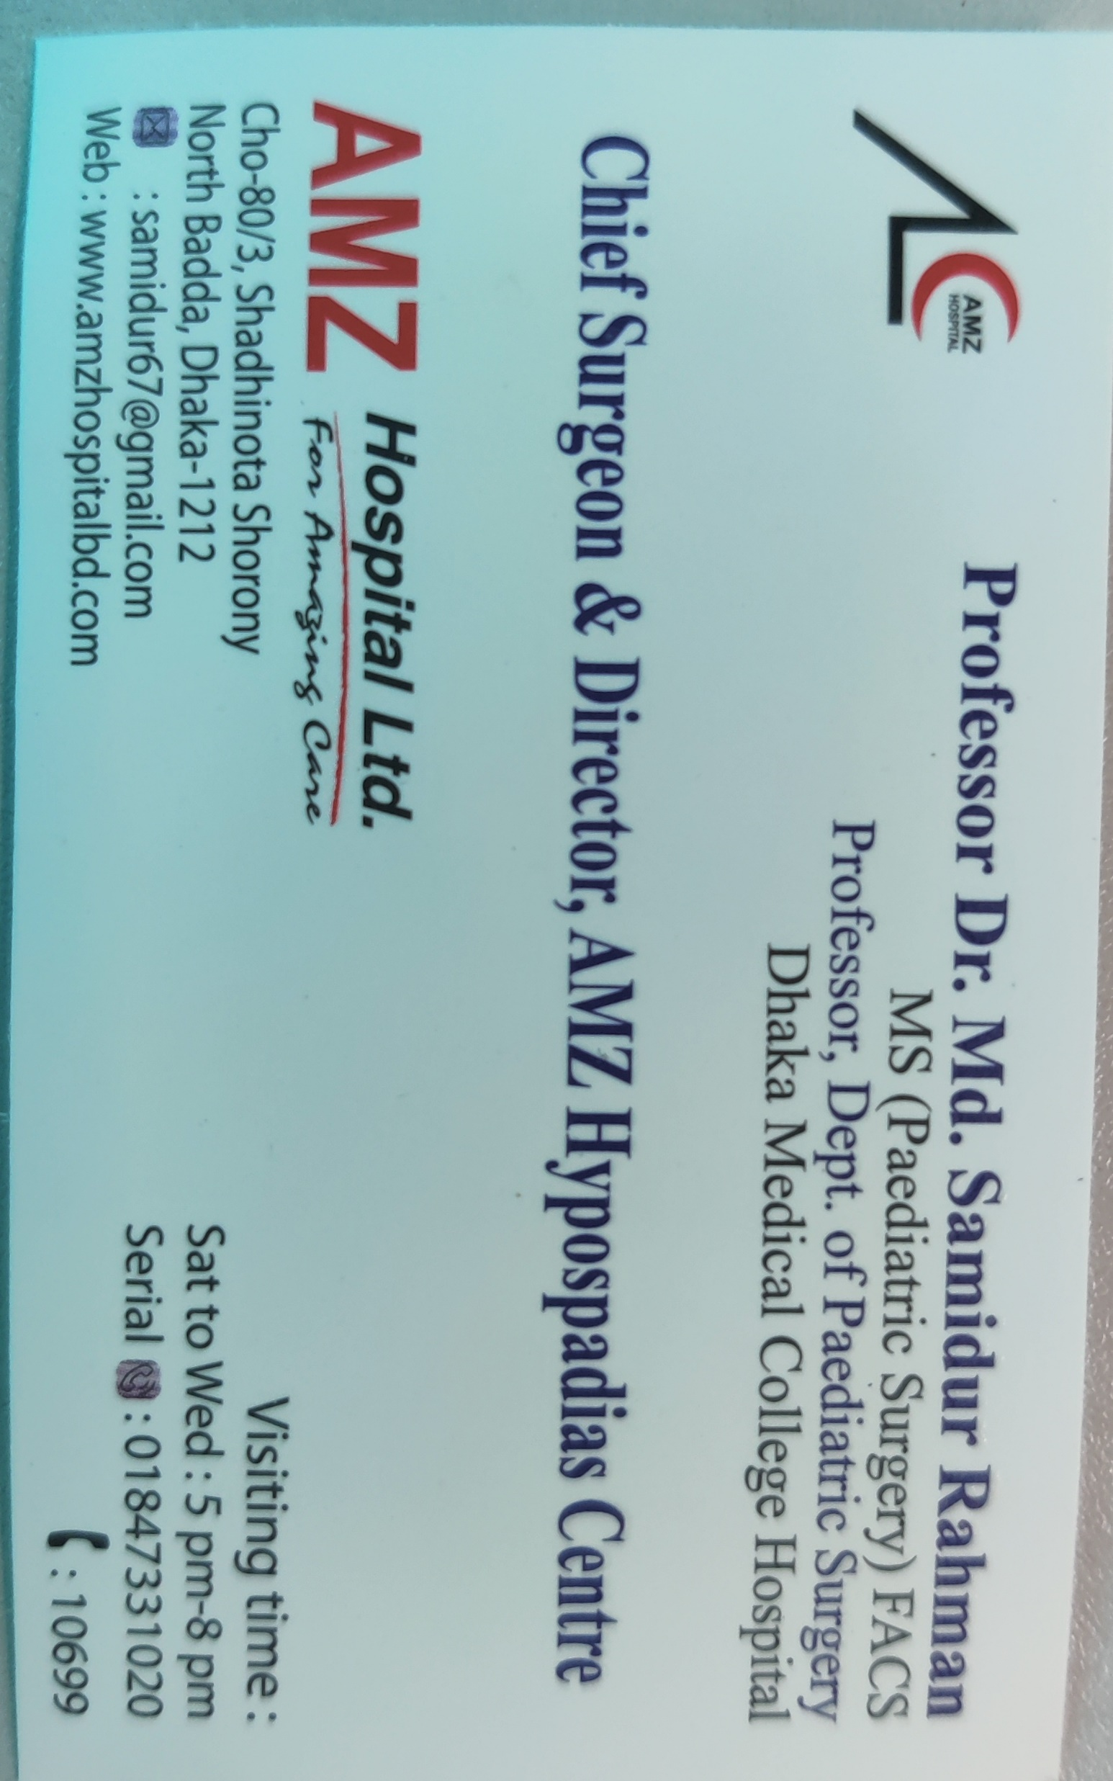
Information
Name of center – AMZ Hypospadias center
Youtube channel-AMZ Hypospadius center
Website –www.amzhospitalbd.com
Email address- samidur67@gmail.com
Slogan- ‘Total care of Hypospadias’ – our social commitment
Address
AMZ Hypospadias center
Cha 80/3
Sadhinota shoroni,
Uttor Badda.
Hot line-10699

Slide 26
THANK YOU ALL
Try to avoid complications
Improving our surgical skill
MISSON
VISION
WE HAVE LONG WAY TO GO--

