Slide 2
The Hypospadias World!!

Slide 3
Re-do Urethroplasty: Understanding and learning
Presented by:
Prof. Dr. Samidur Rahman
Department of pediatric surgery
Dhaka Medical College, Dhaka

Slide 4
Re-do Urethroplasty
Wide variation of techniques for hypospadias surgery and diversities of result strongly indicates the hidden challenges of this topics.

Slide 5
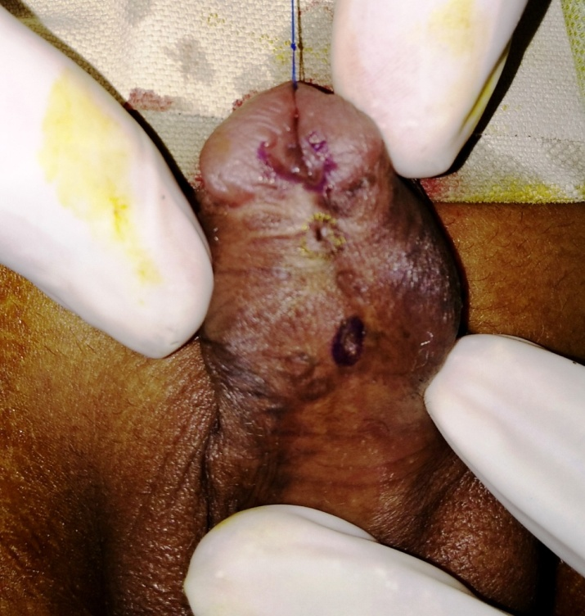
When we need to do re-do surgery
Failed hypospadias
Multiple fistulas ( specially at corona)
Partial glance dehicsence
multiplefistulas
Myers JB J.Urol 2012, Barbagli G J. Urol 2010
Notes:
x

Slide 6
….continued
Residual chordee
Unsatisfactory esthetic appearance of external genitalia
Combined
Myers JB J.Urol 2012, Barbagli G J. Urol 2010

Slide 7
….condinued
Urethral stricture with /without diverticulu
Glance dehiscence with poorly supported neourethra
Myers JB J.Urol 2012, Barbagli G J. Urol 2010

Slide 8
Partial glance dehicsence
Residual chordee with redundant skin & BMG
multiplefistulas
Fistula with thin skin bridge
Glance dehicsence

Slide 9
Why we face such complications
Wrong selection of inappropriate techniques during primary surgery.
Hypospadias surgeon’s inexperience/ lack of adequate training.
Soft tissue Infection.
May be the integral healing properties of native tissue.
Combined factors.
Patients factors like
Type, glance size, chodee, use of steroid( W. snadgrass 2017)

Slide 10
Pitfalls or challenges of redo surgery
Lack of past surgical history in detailed-
Loss of virginity/Inadequacy of urethral plate
Unavailability of well vascularized native tissues
Bad scars.
Pt &/or parents compliance
initial features of hypospadias
Applied procedure
Detailed OT note(operative difficulties/problems)
Possible causes of failure
(Gianantonio,M. 2006)

Slide 11
Planning for surgery
Step 1:-a) Critical analysis of presenting Anatomic features.
Meatus with perimeatal tissue
Urethral plate
No of fistulas
Contour & configuration of glans
Assessment of residual chordee
Penile skin amount & quality (texture, supple)
Amount of scar (where & how much)
Availability and vascularity of native tissue
meatus
Scar tissue
fistula1
Fistula 2
(Jone M Park, Devid A Bloom operative ped. Surgery, 2012.)

Slide 12
Planning of surgery
Step 2:-
Counseling with parents & patient.
Problems with likely etiology
Pros & Cons of the scenarios
what you want to do diagrammatically
Probable complications with the views of corrective scope
Sometimes needs to give proper guideline for special center/ Expert surgeon
for establishing a Realistic expectation & Acceptance And faithful relation.

Slide 13
Planning of surgery
Step 3:- Surgical correction of defects.
Surgery should be done by an Expert & well acquainted hypospadic surgeon (who have a good learning curve & usually do at least 30-40 cases/ year.)
High maintenance of the ideal “principles of hypospadias surgery” like
Try to salvage urethral plate or sometimes native skin is used for neourethra.
W. Snodgrass 2010

Slide 14
Planning of surgery
Step 3:- cont.
Urethral plate- healthy, non scared, supple, & wide > 8mm: Neourethra by Snodgrass procedure
Urethral plate- narrow, healthy :Graft augmented Snodgrass or “Snod-graft”procedure
(Hyes MC & Malone 19999)

Slide 15
Planning of surgery
Step 3 cont.
Distal Meatus, narrow plate, Proximal ventral skin healthy:Methew procedure with Hadidi modification
Some times where there is sufficient prepuchial skin: Onlay graft may be useful .
Supporting the neourethra by well vasculised dartos or spongious tissue.
Penile coverage with acceptable cosmesis.

Slide 16
Planning of surgery
In stage procedure
Excise all scar tissues
Correction of the chordee if needed
take the Buccal mucosal graft as it has got potentiality of easy neovuscularisation & malleable
Can use the testosteron emulssion prior to urethroplasty for 3-4 wks
In 2nd stage Urethroplasty with the grafted mucosa
Excess scar tissuse
Moderate to severe chordee
Lack of native skin
( Bracka A. 1995 and Snodgrass W.T. 2004)

Slide 17
Post surgical care
Keep the stent > 10 days
Cheek the dressing on 5th POD
In case of graft try to keep grafted bed wet
Parenteral antibiotic for at least 3 days
Erection & straining on defecation should be avoided
Dilatation with Ramson feeding tube impregnated by low potential steroid ointment

Slide 18
Follow up
Early discharge of child with an apparent successful repair Without long term follow up may be just a way to sweep ‘problems under the carpet’.
Should be for prolonged period
Meatal status
Urinary flow by clinically & uroflowmerty
Acceptability of chordee < or> 15-20 degree
Cosmetic appearance of penis and external genitalia
Further complication if any
(https//dol.org/10.1016/J.eururo.2006.02.014)

Slide 19
Lesions and Learning
Operation note in details with all presenting features including per-operative difficulties in primary procedure should be mentioned
Hypospadias surgery should not be done by occasional operator (30-40cases/yrs is desirable) even more relevant for complex redo cases.
(Manzoni, G. Bracka, A. 2004)

Slide 20
Lesions and Learning
Principles of hypospadias surgery should be strictly maintained.
Should be done in skilled & specialized center
Critical analysis of features and operational
mapping is essential
Finally hypospadias surgeon should try to
achieve ‘the long learning curve’.
Manzoni G, Bragka A. 2004, and Hadidi A` 2004

