Slide 2
The Hypospadias World!!

Slide 3
Re-do Urethroplasty: Understanding and learning
Presented by:
Prof. Dr. Samidur Rahman
Department of pediatric surgery
Dhaka Medical College, Dhaka

Slide 4
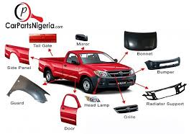
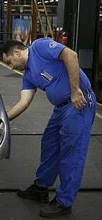
Redo-Urethroplasty
Primary urethroplasty
Redo-Urethroplasty

Slide 5
Re-do Urethroplasty
Wide variation of techniques for hypospadias surgery and diversities of result strongly indicates the hidden challenges of this topics.

Slide 6
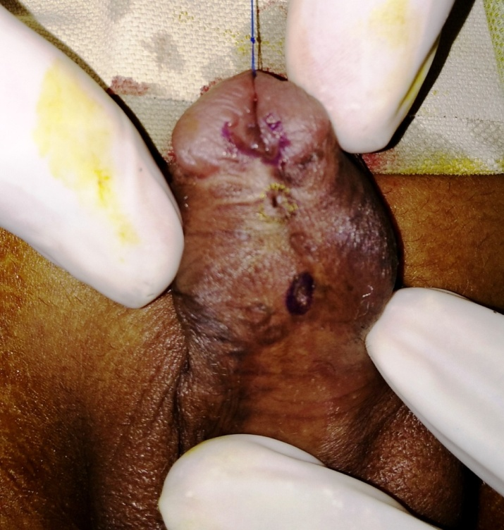
When we need to do re-do surgery
Failed hypospadias
Multiple fistulas
( specially at corona)
Partial glance dehicsence
multiplefistulas
Myers JB J.Urol 2012, Barbagli G J. Urol 2010
Notes:
x

Slide 7
….continued
Residual chordee
Unsatisfactory esthetic appearance of external genitalia
Residual chordee
Glance dehiscence+ uglylooking
Unsatisfactory esthetic appearance+bad scar
Myers JB J.Urol 2012, Barbagli G J. Urol 2010

Slide 8
….condinued
Urethral stricture with /without diverticulum
Glance dehiscence with poorly supported neourethra
Combined
Divreticulum
Unsupported urethra
Myers JB J.Urol 2012, Barbagli G J. Urol 2010

Slide 9
Why we face such complications
Wrong selection of inappropriate techniques during primary surgery.
Hypospadias surgeon’s lack of experience/ adequate training.
Soft tissue Infection.
Integral healing properties of native tissue.
Patients factors like
Type, glans size, chordee, use of steroid
W. snadgrass 2017

Slide 10
Pitfalls or challenges of redo surgery
Lack of past surgical history in detailed-
Loss of virginity/Inadequacy of urethral plate
Unavailability of well vascularized native tissues
Bad scars.
Pt &/or parents compliance
initial features of hypospadias
Applied procedure
Detailed OT note(operative difficulties/problems)
Possible causes of failure
(Gianantonio,M. 2006)

Slide 11
Planning for surgery
Step 1:-a) Critical analysis of presenting Anatomic features.
Meatus with perimeatal tissue
Urethral plate
No of fistulas
Contour & configuration of glans
Assessment of residual chordee
Penile skin amount & quality (texture, supple)
Amount of scar (where & how much)
Availability and vascularity of native tissue
meatus
Scar tissue
fistula1
Fistula 2
(Jone M Park, Devid A Bloom operative ped. Surgery, 2012.)

Slide 12
Planning of surgery
Step 2:-
Counseling with parents & patient.
Problems with likely etiology
Pros & Cons of the scenarios
what you want to do diagrammatically
Probable complications with the views of corrective scope
Sometimes needs to give proper guideline for special center/ Expert surgeon
for establishing a Realistic expectation & Acceptance And faithful relation.

Slide 13
Planning of surgery
Step 3:- Surgical correction of defects.
Surgery should be done by an Expert & well acquainted hypospadic surgeon (who have a good learning curve & usually do at least 30-40 cases/ year.)
High maintenance of the ideal “principles of hypospadias surgery” like
Try to salvage urethral plate or sometimes native skin is used for neourethra.
W. Snodgrass 2010

Slide 14
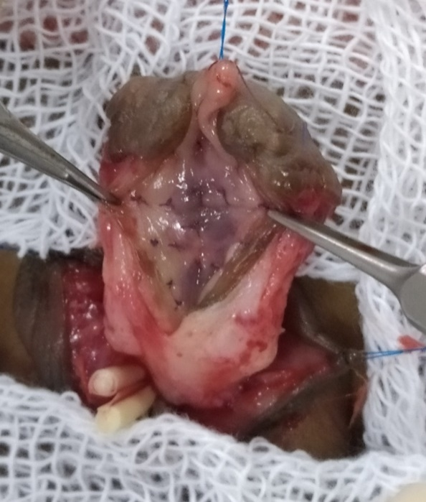
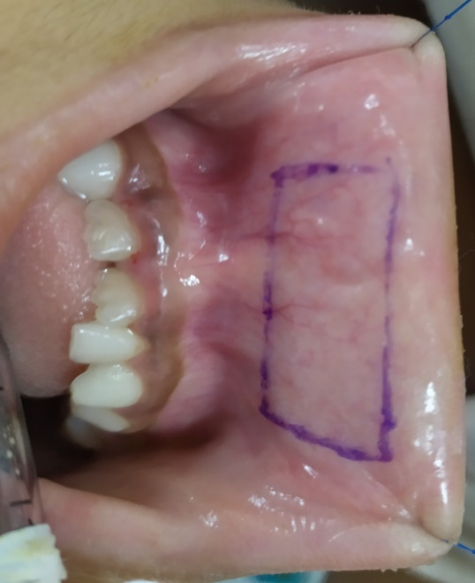
Planning of surgery
cont.
Step 3:-
Urethral plate- healthy, non scared, supple, & wide > 8mm: Neourethra by Snodgrass procedure
Urethral plate- narrow, healthy :Graft augmented Snodgrass or “Snod-graft”procedure
Wide & Healthy Urolethium
Buccal Mucosa
(Hyes MC & Malone 19999)

Slide 15
Planning of surgery
Step 3 cont.
Distal Meatus, narrow plate, Proximal ventral skin healthy:Methew procedure with Hadidi modification
Some times where there is sufficient prepuchial skin: Onlay graft may be useful .

Slide 16
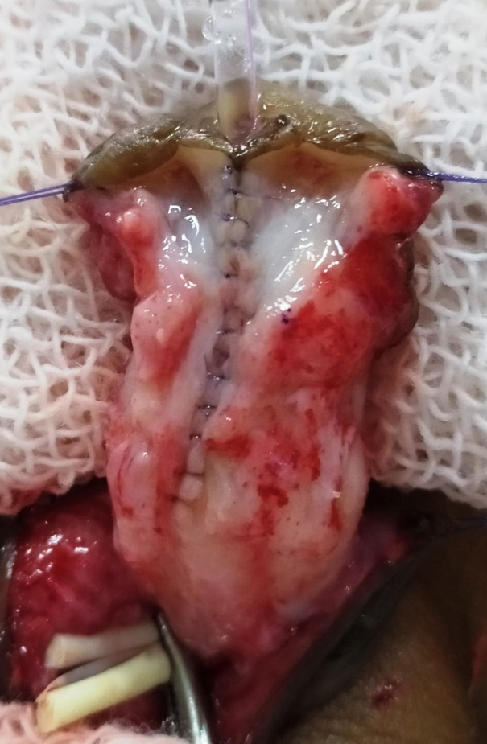
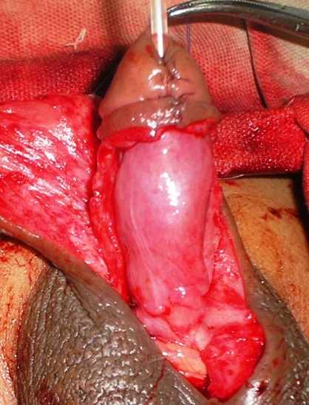
Supporting the neourethra by well vasculised dartos or spongious tissue.
Penile coverage with acceptable cosmesis.
Tunica vaginalis
Supporting layer with Spongious Tissue

Slide 17
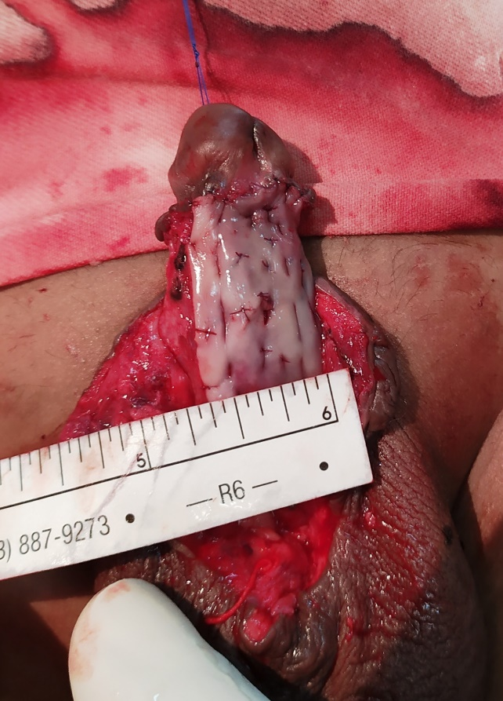
Planning of surgery
In stage procedure
Excess scar tissues
Moderate to severe chordee
Lack of native skin
Excise all scar tissues
Correction of the chordee if needed
take the Buccal mucosal graft as it has got potentiality of easy neovuscularisation & malleable
Can use the testosteron emulssion prior to urethroplasty for 3-4 wks
In 2nd stage Urethroplasty with the grafted mucosa
( Bracka A. 1995 and Snodgrass W.T. 2004)

Slide 18
Algorithm of Management plan
Re-do Cases
Single stage
(Minimal scar & Chordee with urethral plate)
Multi stage
(Bad scar, severe chordee, loss of urethral plate & multiple strictures)
Snodgrass
(Urethral plate Healthy , wide[>8mm], supple
Snodgraft
( Healthy but narrow UP)
Methew/Hadidi (Distal Meatus, narrow plate, Proximal ventral skin healthy)
Onlay Graft
(Narrow urethral plate with adequate prepuceal skin)
Stage 1- Excision of scar, Correction of chordee & BMG graft
Stage 2- Neo-urethra with grafted plate

Slide 19
Post surgical care
Keep the stent > 10 days
Cheek the dressing on 5th POD
In case of graft try to keep grafted bed wet
Parenteral antibiotic for at least 3 days
Erection & straining on defecation should be avoided
Dilatation with Ramson feeding tube impregnated by low potential steroid ointment

Slide 20
Follow up
Early discharge of child with an apparent successful repair Without long term follow up may be just a way to sweep ‘problems under the carpet’.
Should be for prolonged period
Meatal status
Urinary flow by clinically & uroflowmerty
Acceptability of chordee < or> 15-20 degree
Cosmetic appearance of penis and external genitalia
Further complication if any
(https//dol.org/10.1016/J.eururo.2006.02.014)

Slide 21
Lesions and Learning
Operation note in details with all presenting features including per-operative difficulties in primary procedure should be mentioned
Hypospadias surgery should not be done by occasional operator (30-40cases/yrs is desirable) even more relevant for complex redo cases.
(Manzoni, G. Bracka, A. 2004)

Slide 22
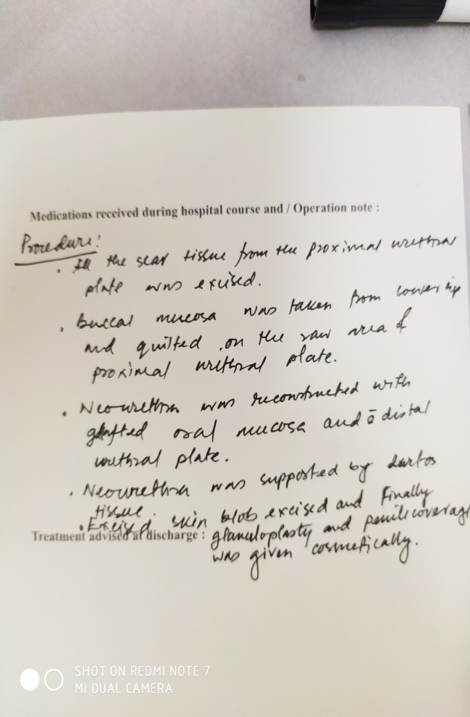
CONVENTIONAL & IDEAL OT NOTE

Slide 23
Lesions and Learning
Principles of hypospadias surgery should be strictly maintained.
Should be done in skilled & specialized center
Critical analysis of features and operational
mapping is essential
Finally hypospadias surgeon should try to
achieve ‘the long learning curve’.
Manzoni G, Bragka A. 2004, and Hadidi A` 2004

Slide 24
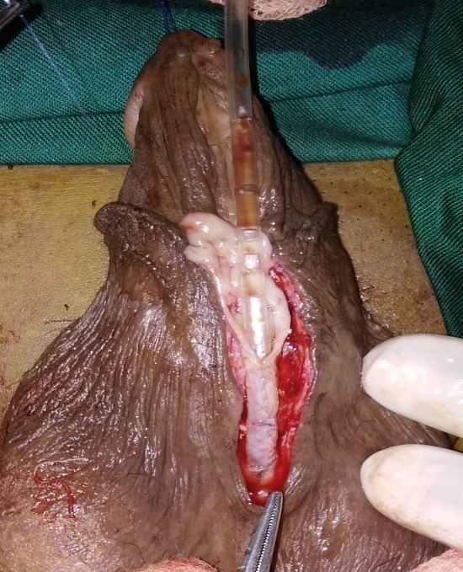
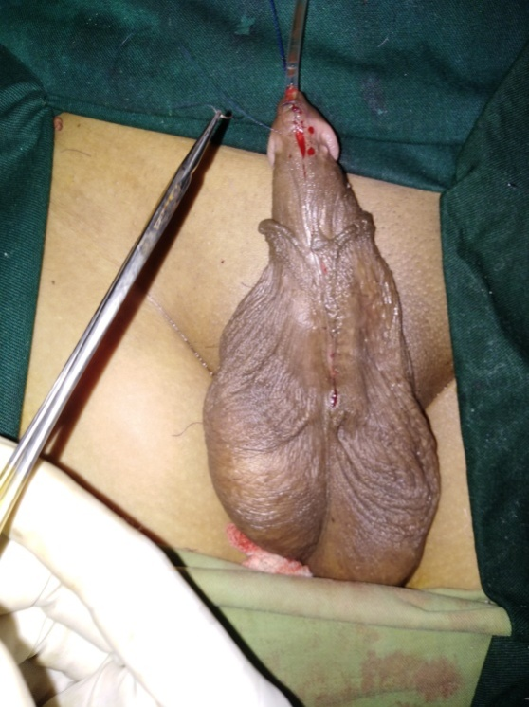
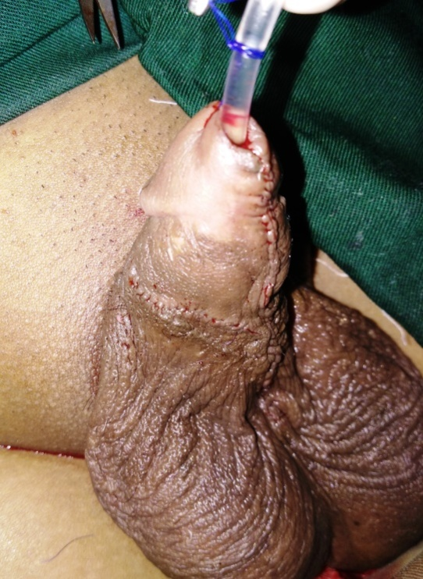
Re-do Surgery

Slide 25
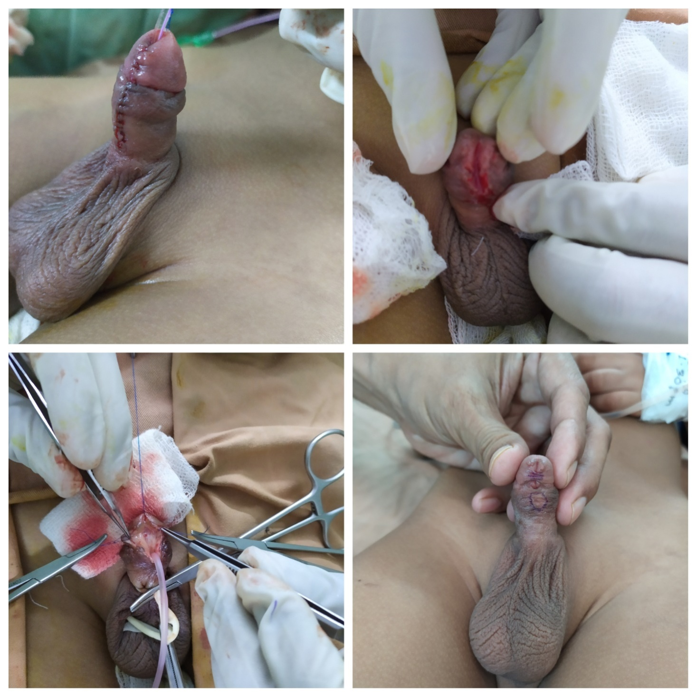
Large fistula at corona with unsupported neourethra,wide plate

Slide 26
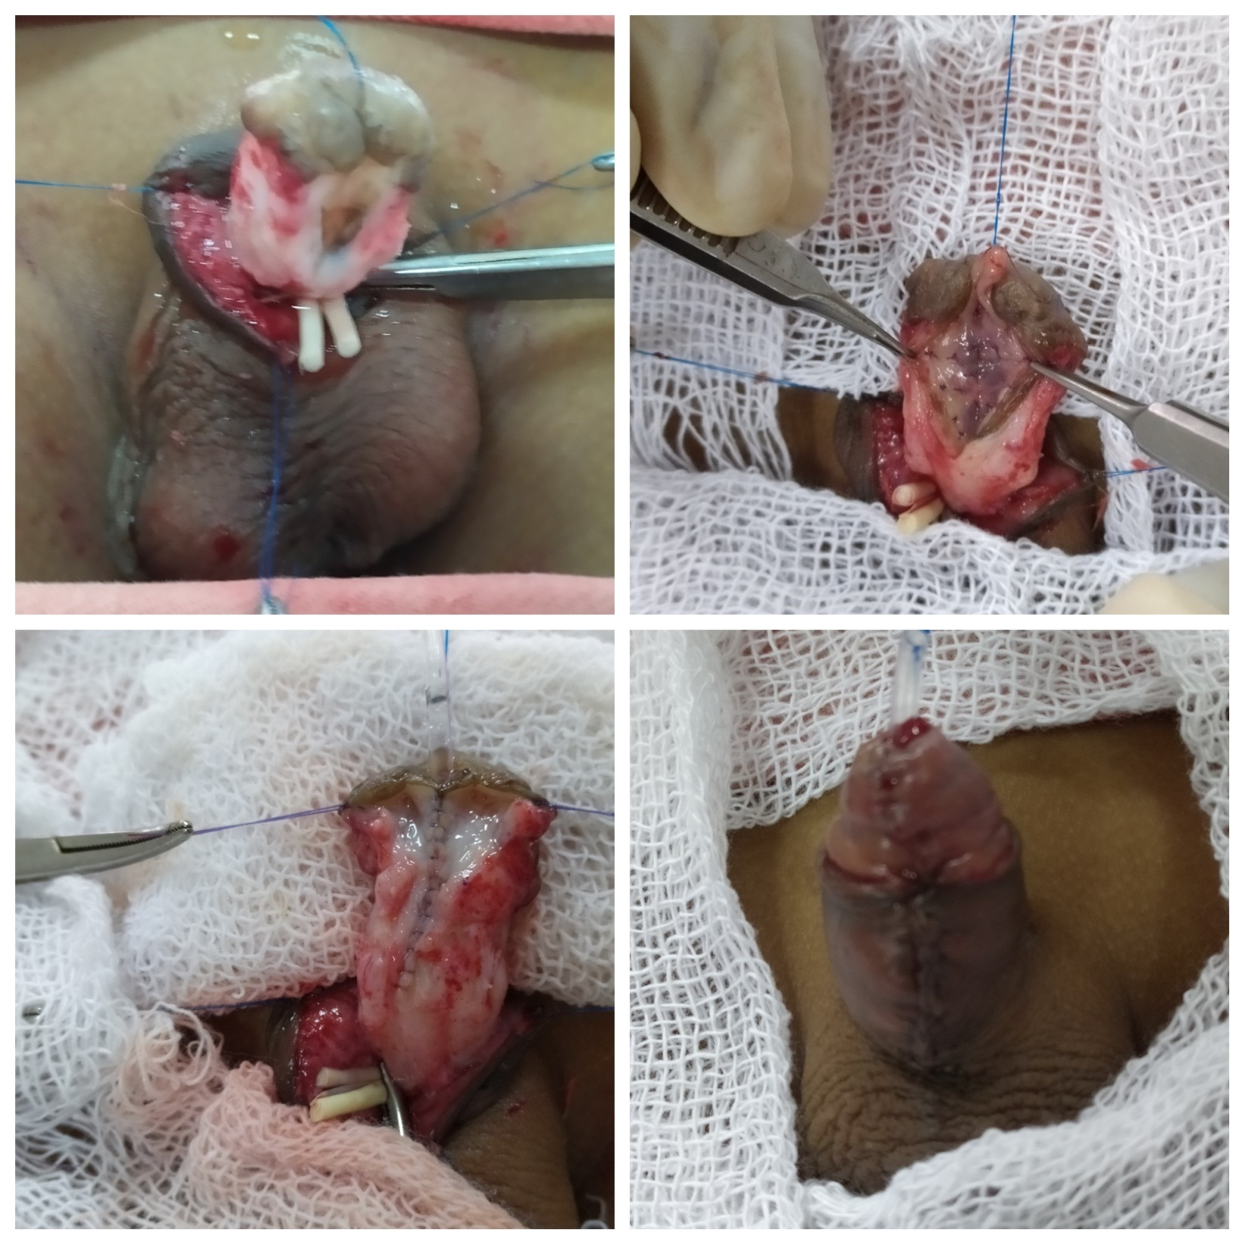
Glans dehiscence with narrow but healthy urethral plate with chordee

Slide 27
UP-COOMING PRESENTATION
ON LONG LEARNING CURVE OF HYPOSPADIAS JOURNEY (HIWAY):
WHERE YOU STAND ?
(AS A PEDIATRIC SURGEON)

